Slide 1
Fundamentals of Algorithms
MCS - 2
Lecture # 11

Slide 2
Merge Sort
Using
Divide & Conquer Strategy

Slide 3
Merge Sort
Split array A[0..n-1] into about equal halves and make copies of each half in arrays B and C. (Divide)
Sort arrays B and C recursively. (Conquer)
Merge sorted arrays B and C into array A as follows: (Combine)
  Repeat the following until no elements remain in one of the arrays:
    compare the first elements in the remaining unprocessed portions of the arrays
    copy the smaller of the two into A, while incrementing the index indicating the unprocessed portion of that array
  Once all elements in one of the arrays are processed, copy the remaining unprocessed elements from the other array into A.

Slide 4
Merge Sort: Example 1
Divide & Conquer
Combine or Merge

Slide 5
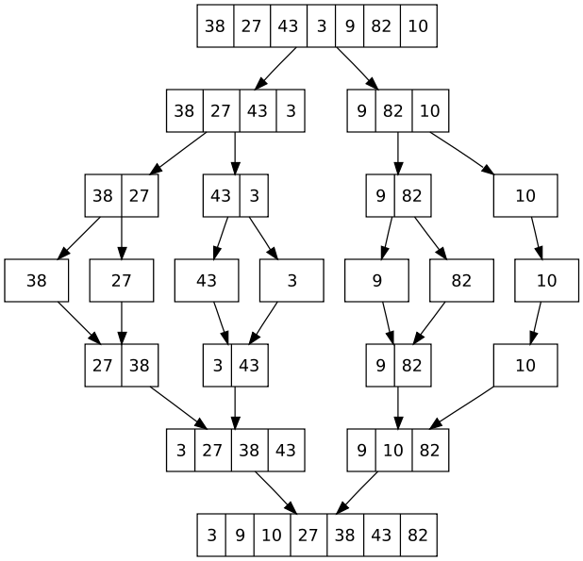
Merge Sort: Example 2

Slide 6
Pseudo-code of Merge Sort Algorithm
Division Part
MERGE-SORT (Array A, integer left, integer right)
1 IF (left < right)
2 THEN mid ← (left + right) / 2
3 MERGE-SORT (Array A, left, mid) // sort A[left…… mid]
4 MERGE-SORT (Array A, mid +1, right) // sort A[mid +1……right]
5 MERGE-SORT (Array A, left, mid, right) // merge two pieces

Slide 7
Pseudo-code of Merge Sort Algorithm
Combining Part
MERGE-SORT (Array A, int left, int mid, int right)
1 int B[left……right]; int i ← k ← left; int j ← mid + 1
2 WHILE (i ≤ mid) AND (j ≤ right)
3 DO IF (A[i] ≤ A[j])
4 THEN B[k++] ← A[i++]
5 ELSE B[k++] ← A[j++]
6 WHILE (i ≤ mid)
7 DO B[k++] ← A[i++]
8 WHILE (j ≤ right)
9 DO B[k++] ← A[j++]
10 FOR i ← left to right
11 DO A[i] ← B[i]

Slide 8
Analysis of Merge Sort
First consider the running time of procedure Merge(A, left, mid, right).
Let n = right – left + 1 denotes the total length of both left and right sub-arrays, i.e., sorted pieces.
The merge procedure contains 4 loops, no one is nested.
Each loop can be executed at most n times.
Thus running time of merge is Θ(n).
Let T(n) denotes the worst case running time of MergeSort on an array of length n.
If we call MergeSort with an array containing a single item (n=1), then the running time is constant.
We can just write T(n)=1, ignoring all constants.
For n > 1, MergeSort splits into 2 halves, sorts the two and then merges them together.
The left half is of size[n/2] and the right half is [n/2]
How long does it take to sort elements in sub-array of size[n/2]?

Slide 9
Analysis of Merge Sort
How long does it take to sort elements in sub-array of size[n/2]?
We do not know this but because [n/2] < n for n > 1, we can express this as T([n/2]).
Similarly the time taken to sort right sub-array is expressed as T(n/2).
In conclusion, we have
T(n)=1 if n=1, otherwise T([n/2])+T([n/2])+n
This is called Recurrence Relation, i.e., a recursively defined function.

Slide 10
Good Luck ! ☻

