Slide 1
Fundamentals of Algorithms
MCS - 2
Lecture # 13

Slide 2
Selection Sort

Slide 3
Selection Sort
Idea:
  Find the smallest element in the array
  Exchange it with the element in the first position
  Find the second smallest element and exchange it with the element in the second position
  Continue until the array is sorted
Disadvantage:
  Running time depends only slightly on the amount of order in the file

Slide 4
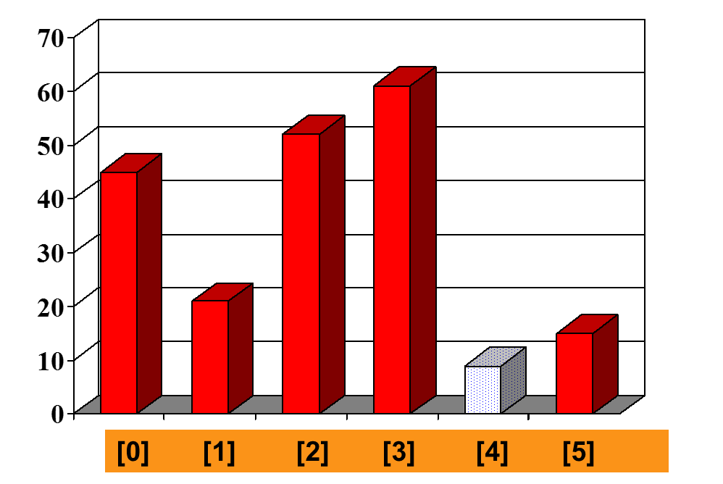
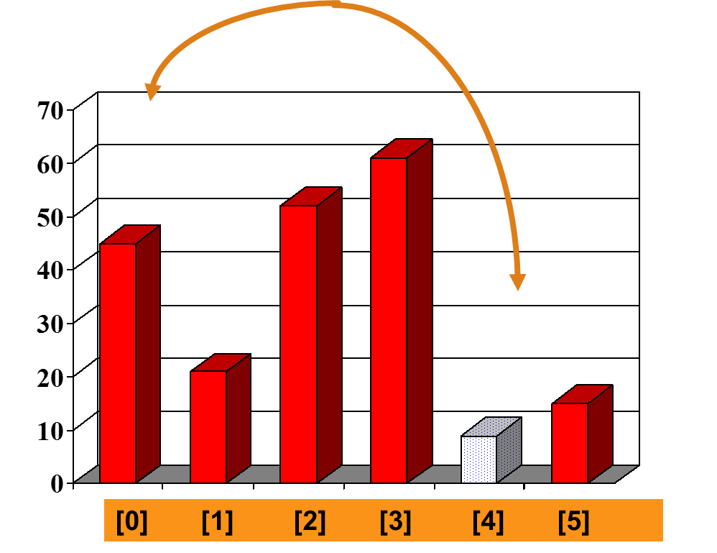
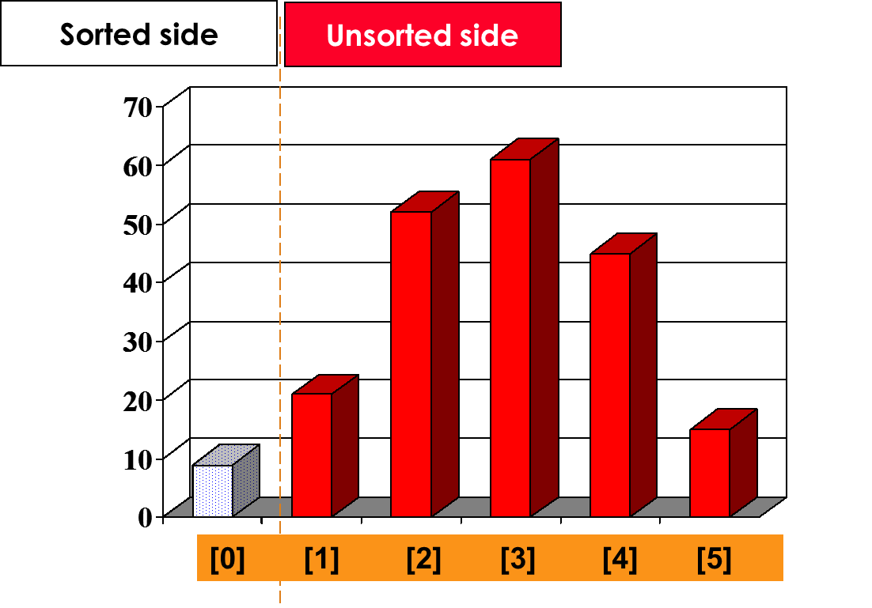
Sorting an Array of Integers
An array of unsorted six integers.
Start by finding the smallest entry.
Swap the smallest entry with the first entry.
Part of the array is now sorted.

Slide 5
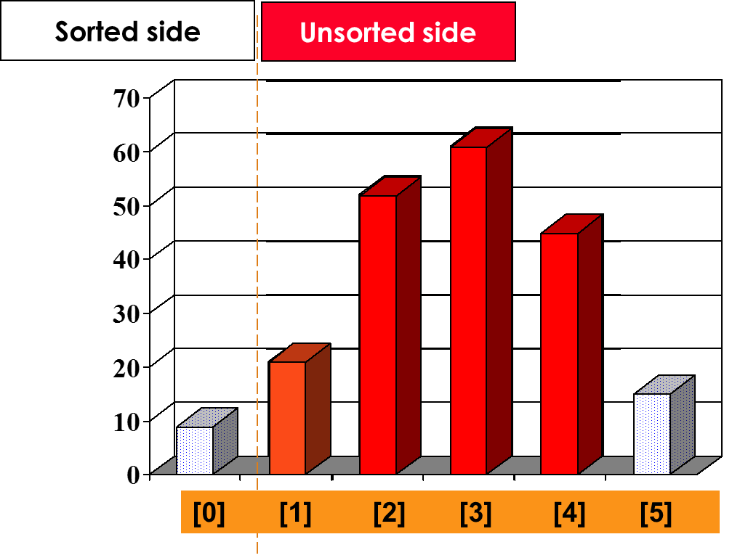
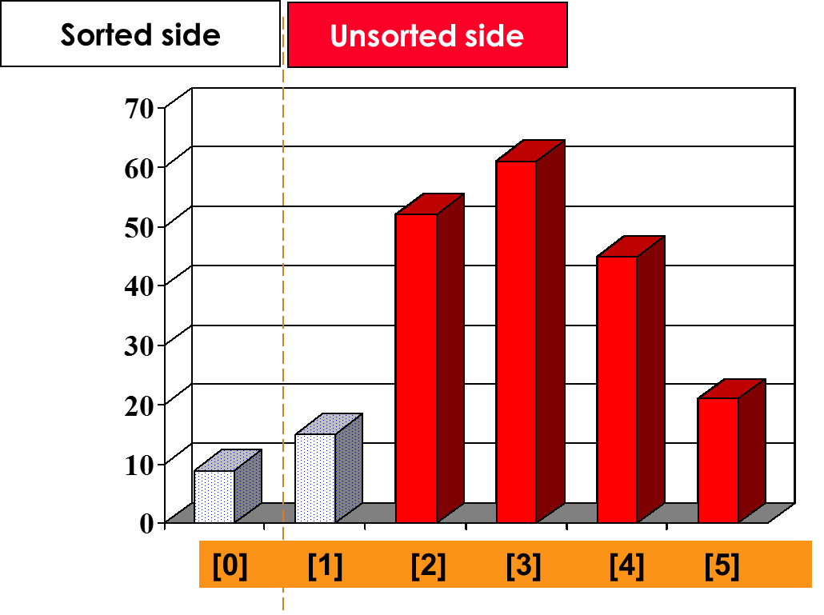
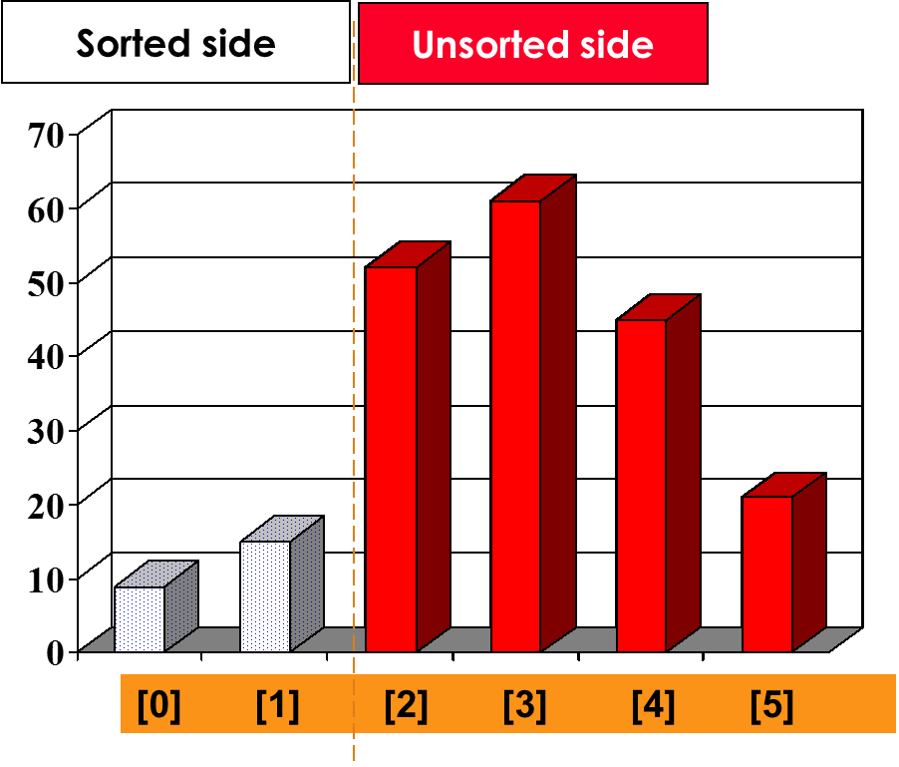
Sorting an Array of Integers
Find the smallest element in the unsorted side
Swap with the front of the unsorted side
Increase size of the sorted side by
one element.

Slide 6
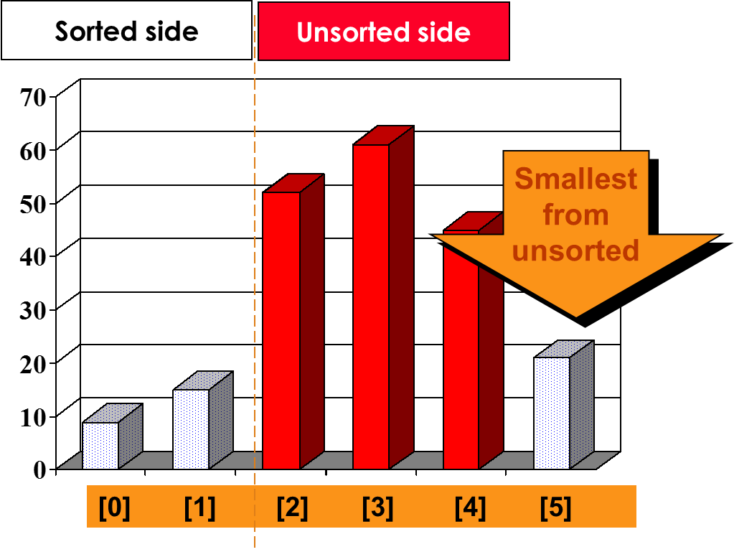
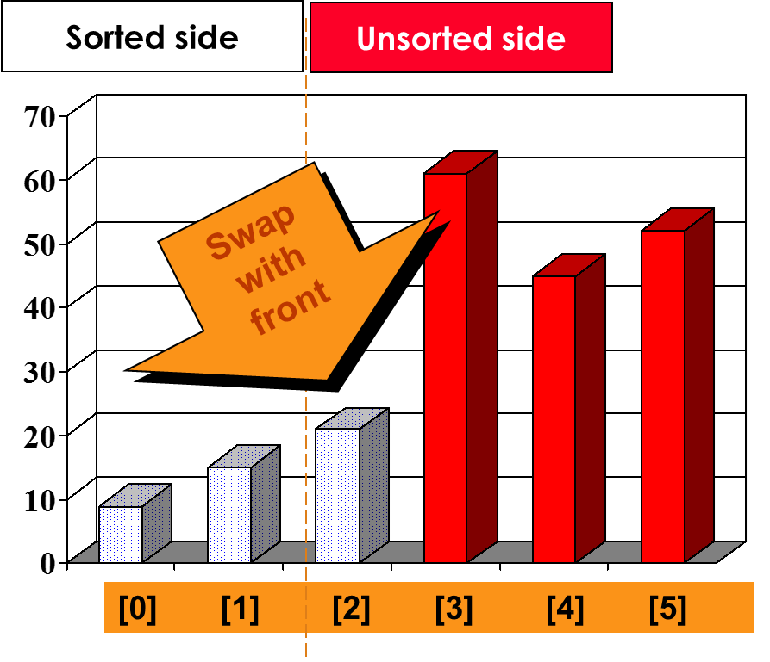
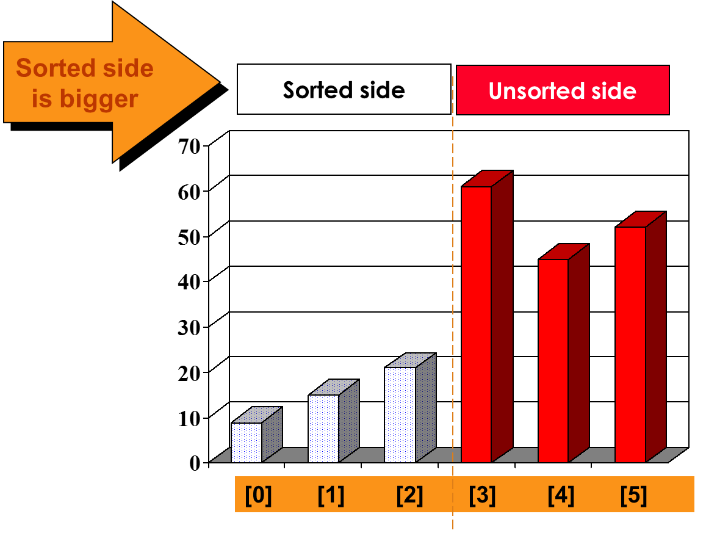
Sorting an Array of Integers
The process continues...

Slide 7
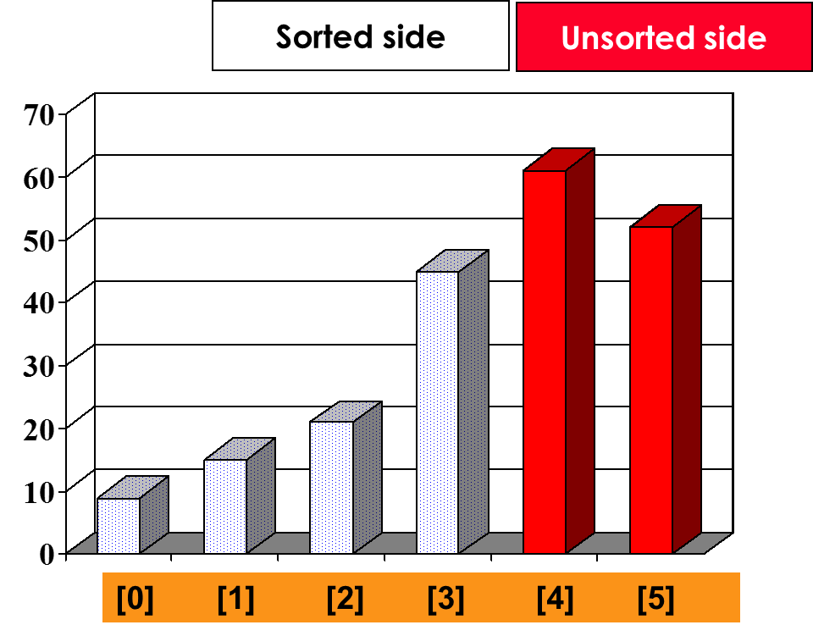
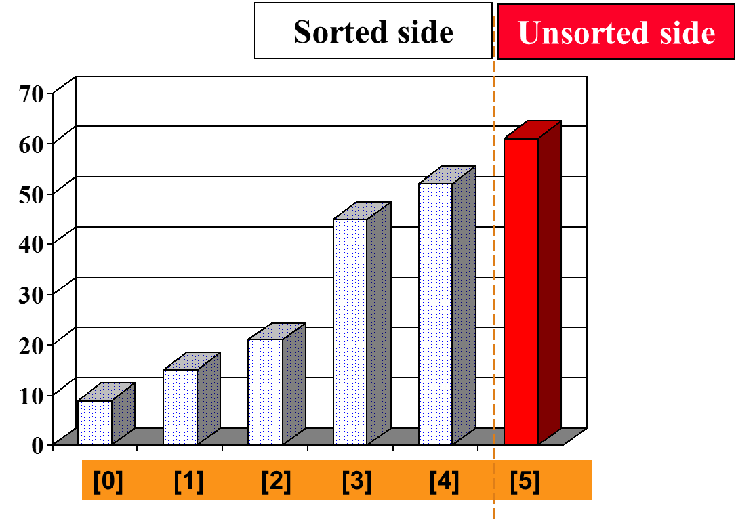
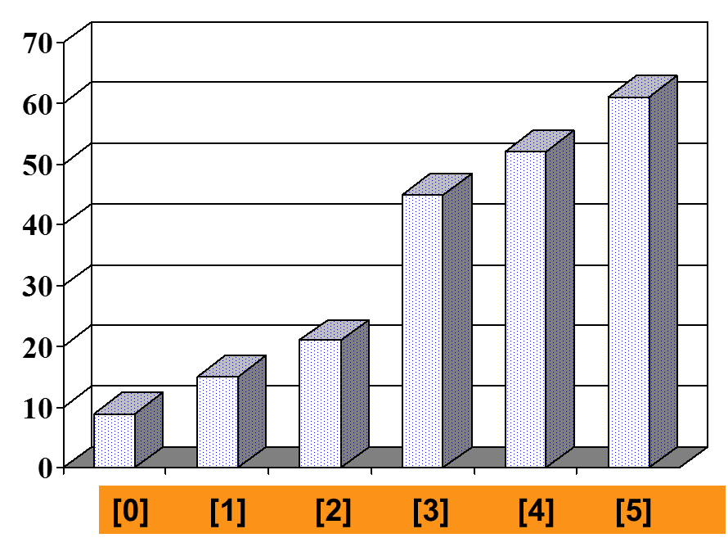
Sorting an Array of Integers

Slide 8

Example
8
4
6
9
2
3
1
1
2
3
4
9
6
8
1
4
6
9
2
3
8
1
2
3
4
6
9
8
1
2
6
9
4
3
8
1
2
3
4
6
8
9
1
2
3
9
4
6
8
1
2
3
4
6
8
9

Slide 9
Pseudo code of Selection Sort Algorithm
SELECTION-SORT(A)
1 n ← length[A]
2 for i ← 0 to n – 1
3 do smallest ← i
4 for j ← (i + 1) to (n – 1)
5 do if A[j] < A[smallest]
6 then smallest ← j
7 if smallest != i
8 then exchange A[i] ↔ A[smallest]

Slide 10
Analysis of Selection Sort Algorithm
With a list of n numbers, we need n – 1 swaps to order it in worst case.
The number of operations does not depend on specific items, it depends only on the number of items.
Outer loop is executed n – 1 times.
Each time through the outer loop, one more item is sorted into position.
To find the total comparisons required, we need to sum the comparisons from each step.
Selecting the lowest element requires scanning all n elements (this takes n − 1 comparisons) and then swapping it into the first position.

Slide 11
Analysis of Selection Sort Algorithm
After the first step, we have (n – 1) comparisons. After the second step, we have (n - 1) + (n - 2) comparisons.
The total number of steps is the sum of integers from 1 to (n – 1)
So, selection sort is O(n²).
Selection sort still needs to check the number that is already sorted whether is need to be moved.
That means if we check selection sort over an already sorted list, it will require same number of steps as it would run on a completely unsorted list. So selection sort has a best case performance on n² which is represented is Ω(n²).

Slide 12
Good Luck ! ☻

