Slide 1
Fundamentals of Algorithms
MCS - 2
Lecture # 15

Slide 2
Bubble Sort

Slide 3
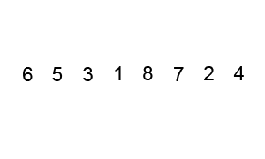

Bubble Sort
The Bubble Sort algorithm looks at pairs of entries in the array, and swaps their order if needed.
Easier to implement, but slower than Insertion sort
Repeatedly pass through the array
Swaps adjacent elements that are out of order.
By doing this, the smaller element bubble to the top, that why this sorting technique is called bubble sort.
Bubble sort is the simplest sorting algorithm, easy to
understand and quick to implement. However, in practice,
it is not recommended.

Slide 4
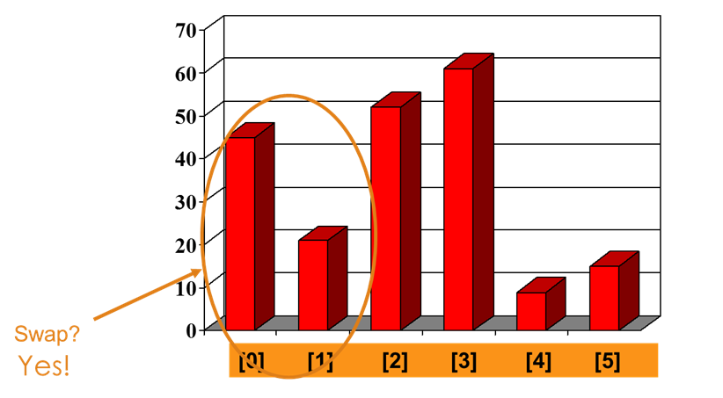
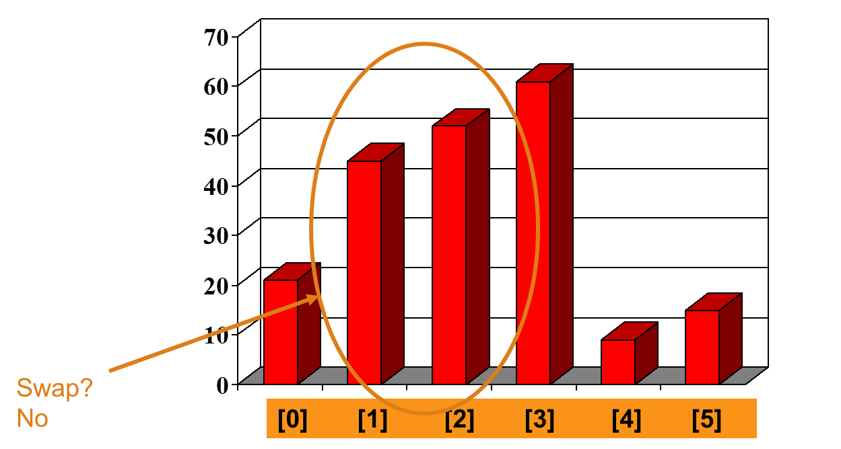
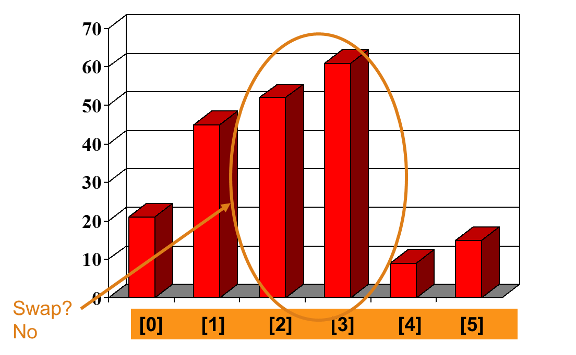
Bubble Sort

Slide 5
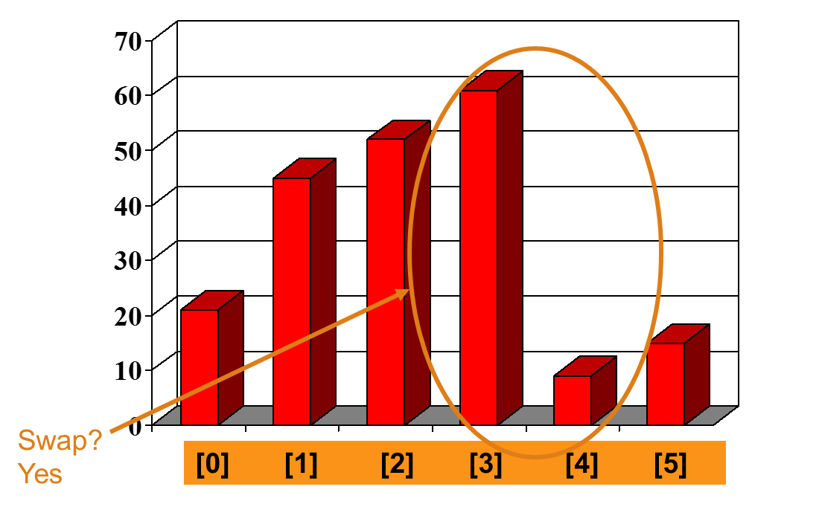
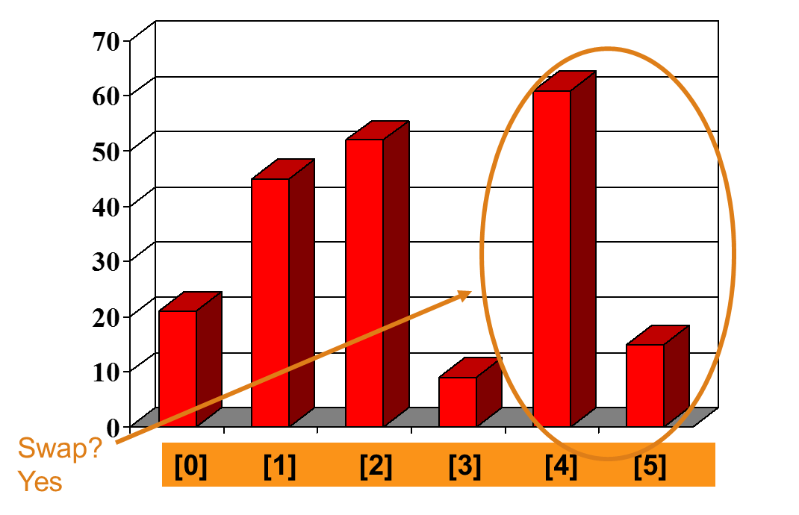
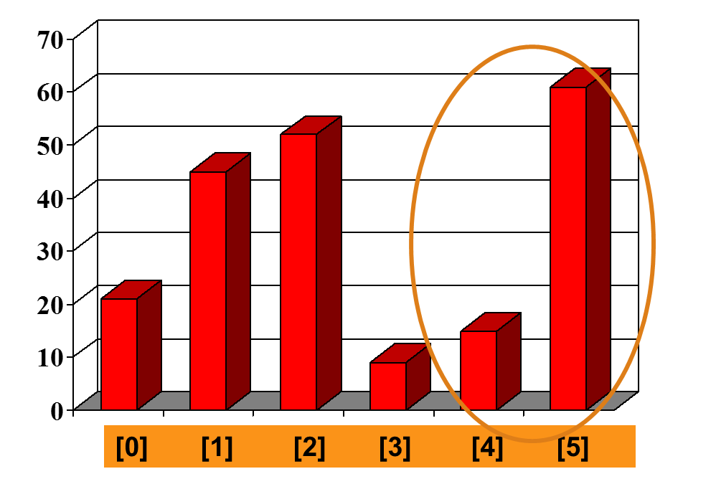
Bubble Sort

Slide 6
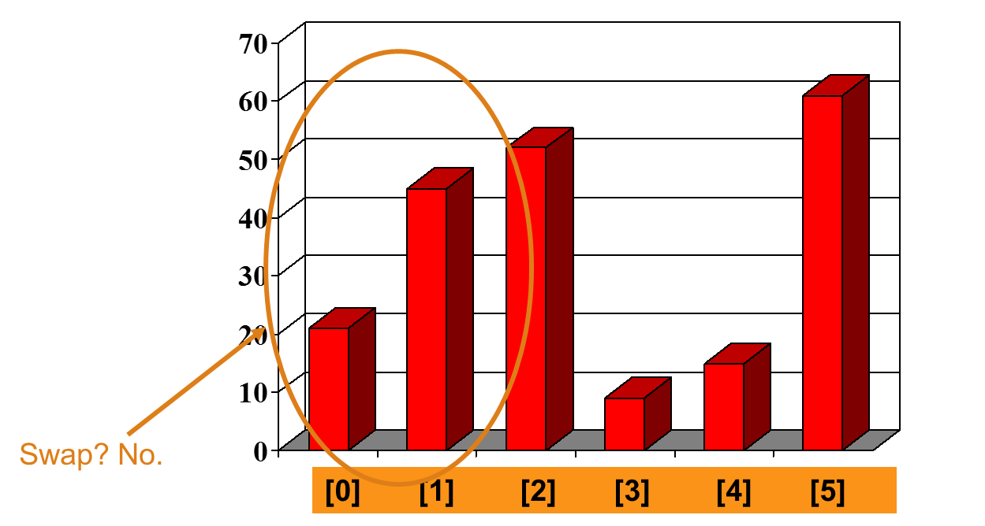
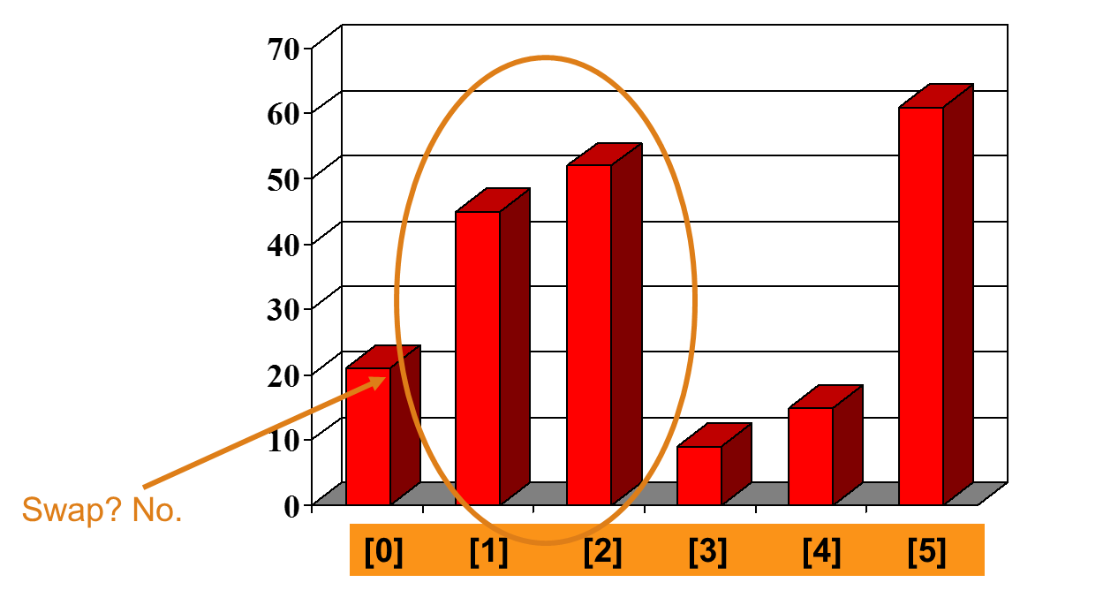
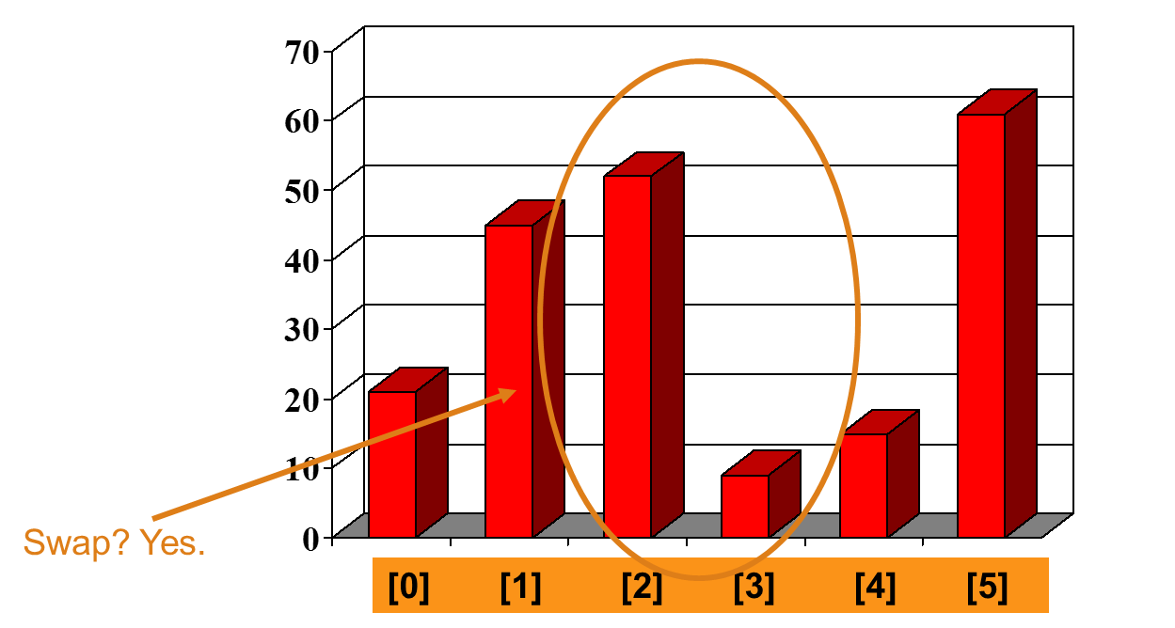
Bubble Sort

Slide 7
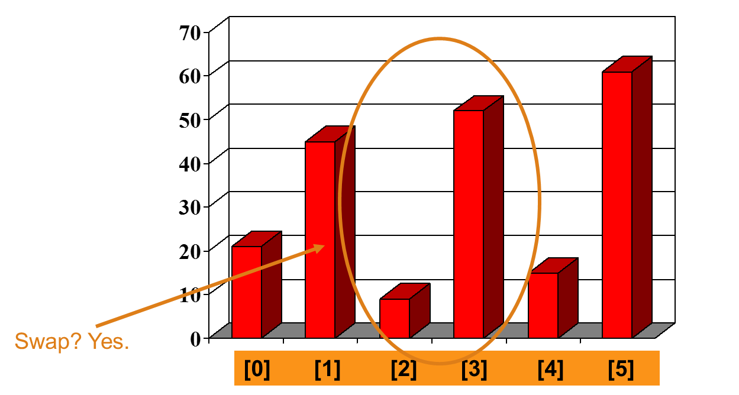
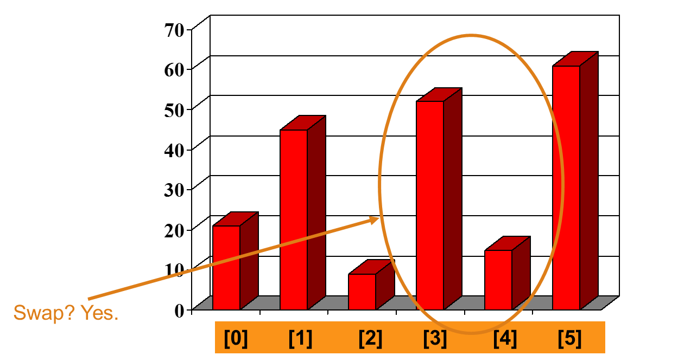
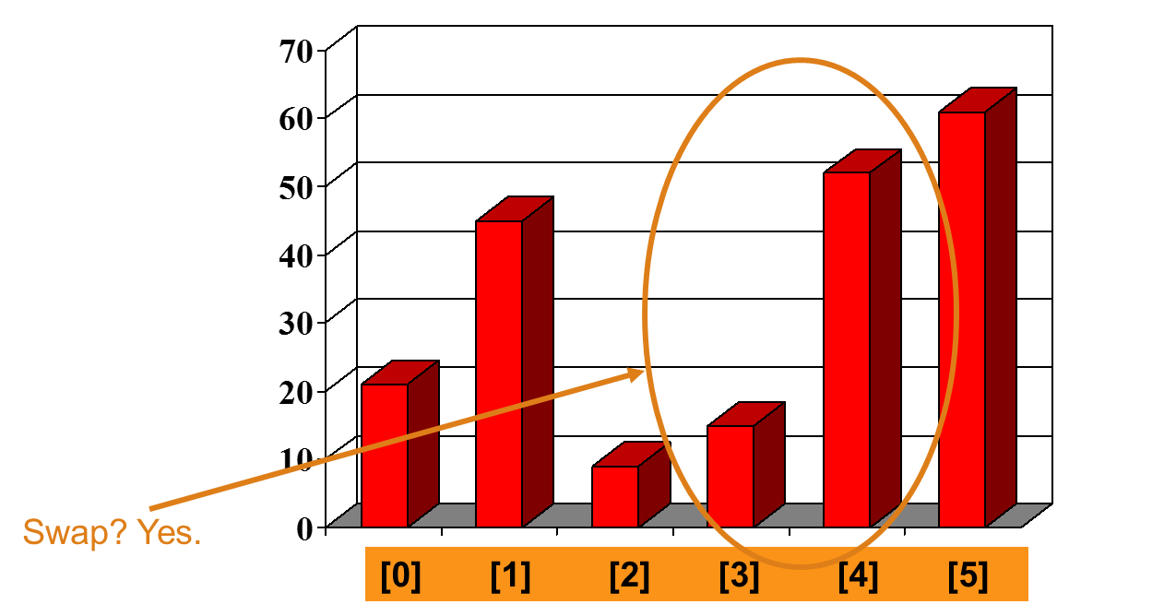
Bubble Sort

Slide 8
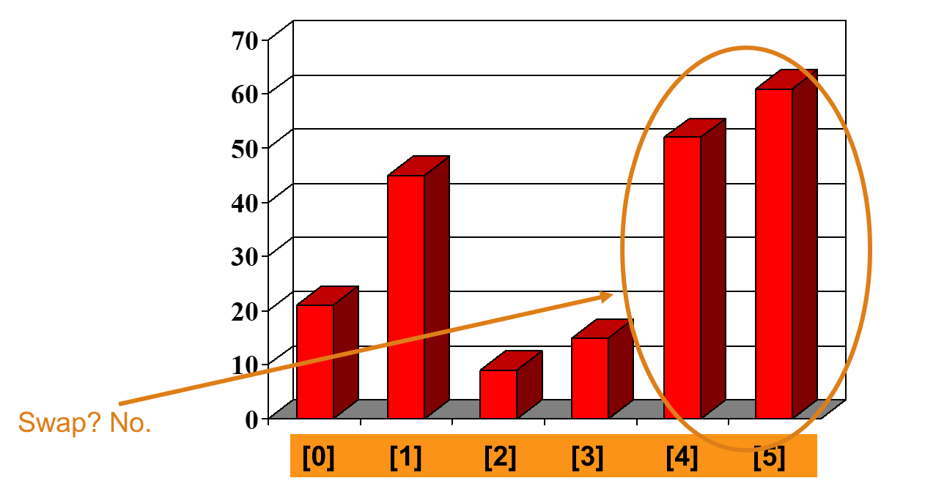
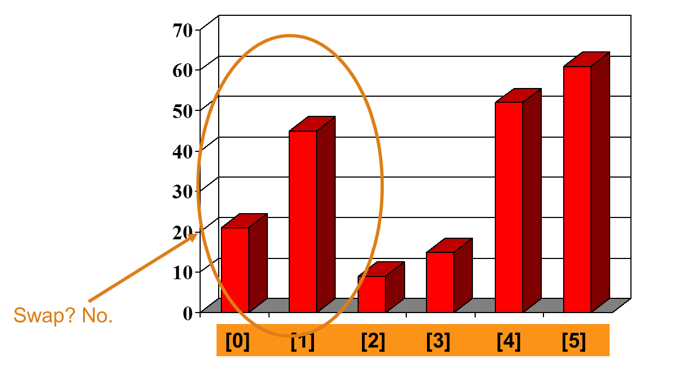
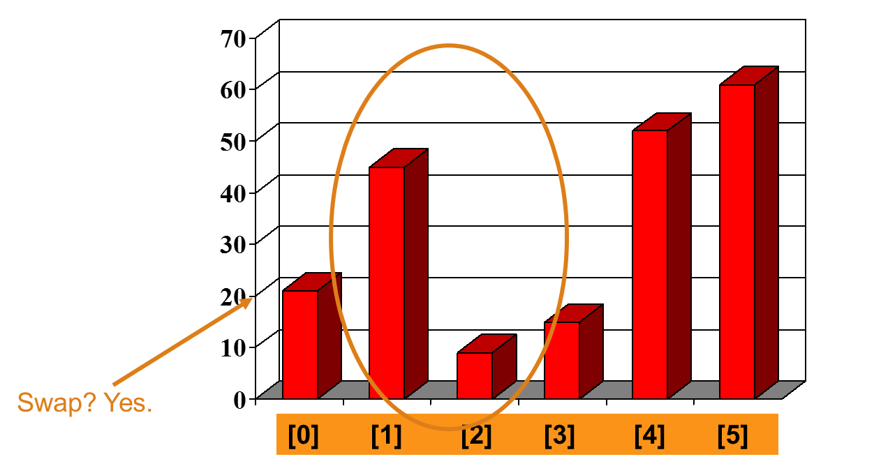
Bubble Sort

Slide 9
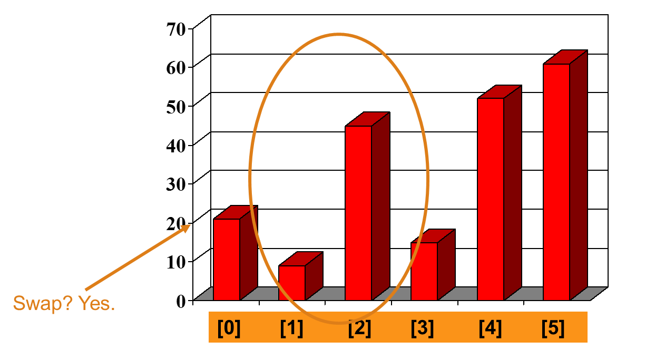
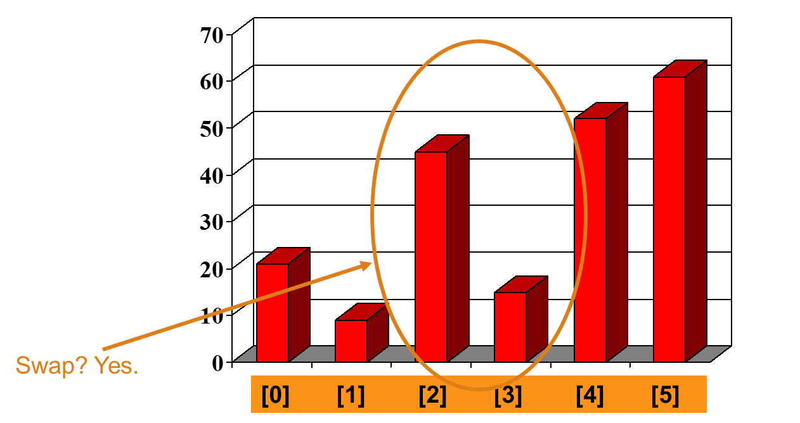
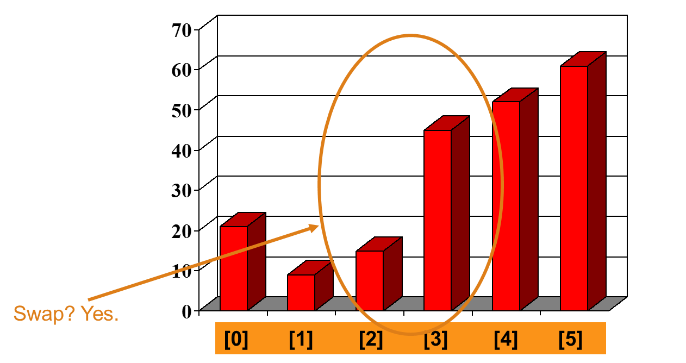
Bubble Sort

Slide 10
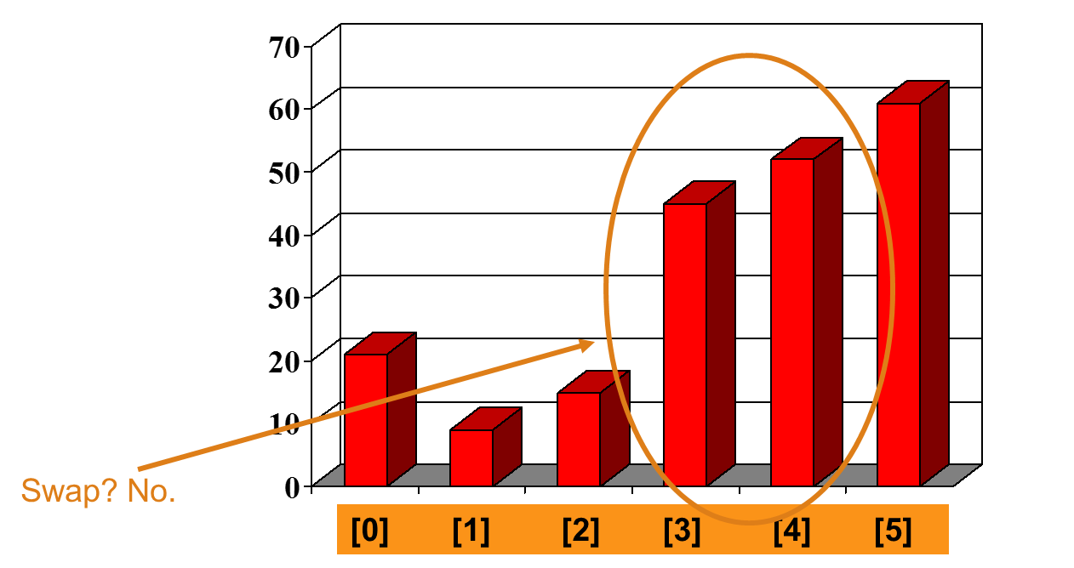
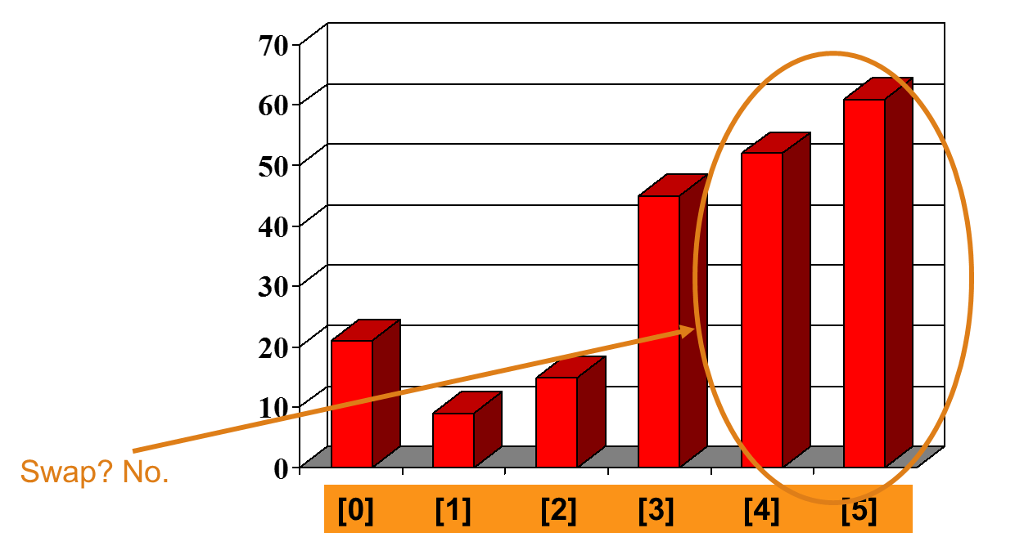
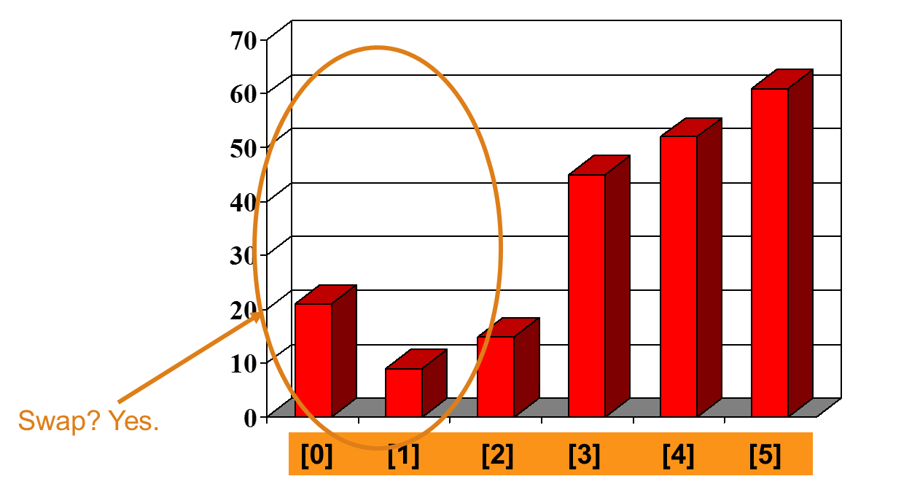
Bubble Sort

Slide 11
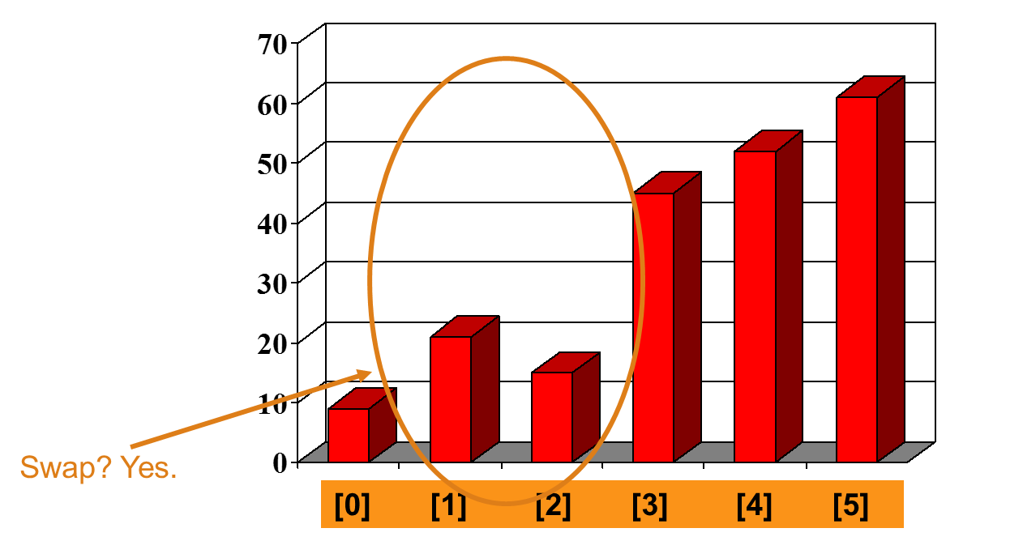
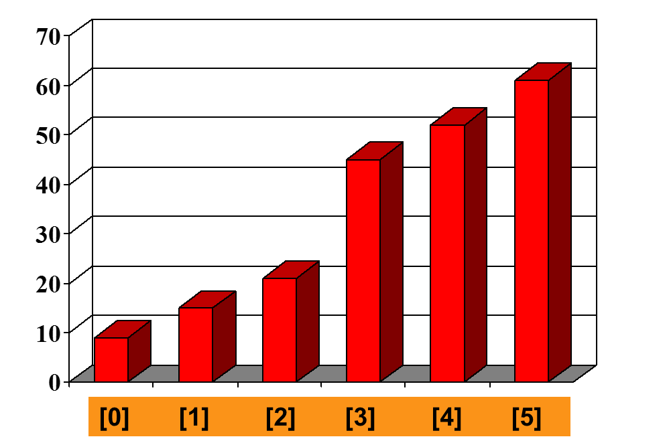
Bubble Sort

Slide 12
Example
8
4
6
9
2
3
1
1
8
4
6
9
2
3
i = 1
j
i = 2
j
8
4
6
9
2
1
3
1
2
8
4
6
9
3
i = 1
j
i = 3
j
8
4
6
9
1
2
3
1
2
3
8
4
6
9
i = 1
j
i = 4
j
8
4
6
1
9
2
3
1
2
3
4
8
6
9
i = 1
j
i = 5
j
8
4
1
6
9
2
3
1
2
3
4
6
8
9
i = 1
j
i = 6
j
8
1
4
6
9
2
3
1
2
3
4
6
8
9
i = 1
j
i = 7
1
8
4
6
9
2
3
j
i = 1
j

Slide 13
Pseudo code of Bubble Sort
BUBBLE-SORT (array A)
n ← length of A
1 for i ← 1 to n-1
2 do for j ← 0 to n-i
3 do if A[j] > A[j +1]
4 then swap A[j] ↔A[j+1]

Slide 14
Analysis of Bubble Sort
The best case for bubble sort occurs when the list is already sorted or nearly sorted.
  In the case where the list is already sorted, bubble sort will terminate after the first iteration, since no swaps were made.
  Any time that a pass is made through the list and no swaps were made, it is certain that the list is sorted.
Bubble sort is also efficient when one random element needs to be sorted into a sorted list, provided that new element is placed at the beginning and not at the end.
  When placed at the beginning, it will simply bubble up to the correct place, and the second iteration through the list will generate 0 swaps, ending the sort.
  Recall that if the random element is placed at the end, bubble sort loses its efficiency because each element greater than it must bubble all the way up to the top.

Slide 15
Analysis of Bubble Sort
The absolute worst case for bubble sort is when the smallest element of the list is at the large end.
Because in each iteration only the largest unsorted element gets put in its proper location, when the smallest element is at the end, it will have to be swapped each time through the list, and it won’t get to the front of the list until all n iterations have occurred.
In this worst case, it take n iterations of n/2 swaps so the order is, again, n²

Slide 16
Analysis of Bubble Sort
Lets talk about average case.
The algorithm for bubble sort requires a pair of nested loops. The outer loop must iterate once for each element in the data set (of size n) while the inner loop iterates n times the first time it is entered, n-1 times the second, and so on.
The total number of comparisons, therefore, is
(n - 1) + (n - 2)...(2) + (1) = n(n - 1)/2 or O(n²)
Best Case: n Average Case: n ² Worst Case: n ²

Slide 17
Good Luck ! ☻

