Slide 1
Fundamentals of Algorithms
MCS - 2
Lecture # 16

Slide 2
Quick Sort

Slide 3
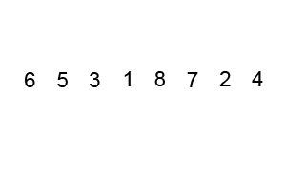
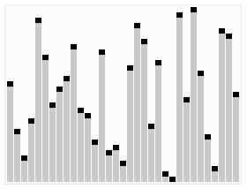
Quick Sort
Fastest known sorting algorithm in practice.
It is being selected in most sorting libraries.
The quicksort algorithm sorts an unordered list based on the divide and conquer strategy.
It divides the unordered list into two sub-lists:
  low elements sub-list, and
  high elements sub-list,
and then recursively sort these sub-lists.
Quicksort algorithm steps
  Pick an element from the list, which is called a pivot.
  Reorder the list with a rule that all elements which are less than the pivot come before the pivot, whereas all elements that are higher than the list come after the pivot. After partitioning the list, the pivot is in its position.
  With the two sub-lists, apply the above steps recursively.

Slide 4
Quicksort
A
piv
Divide step
  Pick any element (pivot) piv in A
  Partition A – {piv} into two disjoint groups
  A1 = {x ∈ A – {piv} | x <= piv}
  A2 = {x ∈ A – {piv} | x > piv}
Conquer step
  Recursively sort A1 and A2
Combine step
  The sorted A1 (by the time returned from recursion), followed by piv, followed by the sorted A2 (i.e., nothing extra needs to be done)
piv
A1
A2

Slide 5
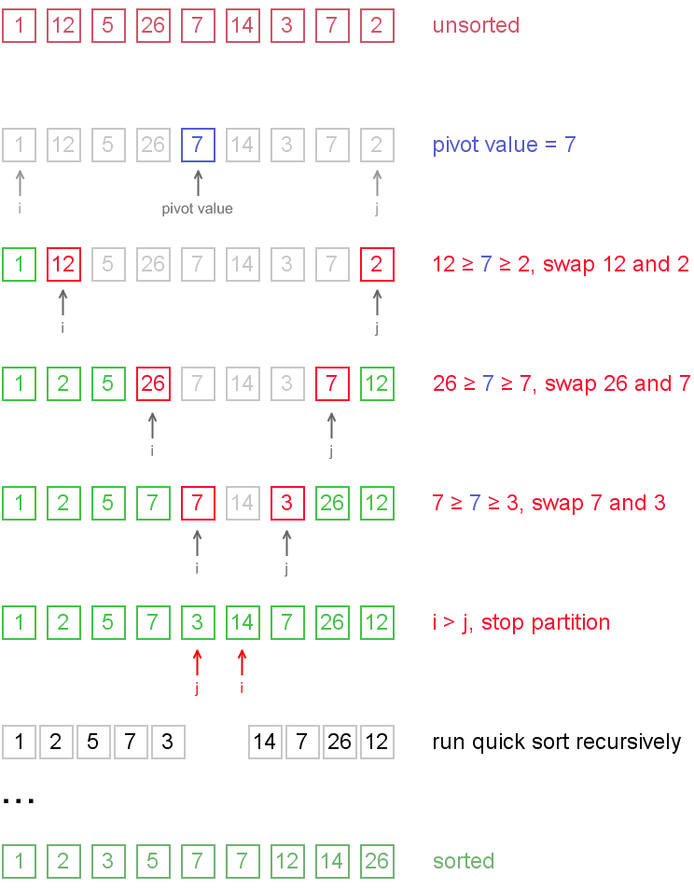
Example

Slide 6
Pseudo code of Quick Sort
Quick-Sort (array A, int left, int right)
1 if (left < right)
2 then piv ← a random index from [left ….. right]
3 swap a[piv] ↔ a[left]
4 q ← Partition (A, left, right) //q is the position of the pivot element
5 Quicksort (A, left, q-1)
6 Quicksort (A, q+1, right)

Slide 7
Partitioning
Partition algorithm partitions the array A[left … right] into three sub arrays about a pivot element piv.
A[left … q-1] whose elements are less than or equal to piv.
A[q] = piv,
A[q+1 … right] whose elements are greater than piv.

Slide 8
Partition Algorithm
PARTITION (array A, int left, int right)
1 piv ← A[left]
2 q ← left
3 for i ← left+1 to right
4 do if A[i] < piv
5 then q ← q+1
6 swap A[q] ↔ A[i]
7 swap A[left] ↔ A[q]
8 return q

Slide 9
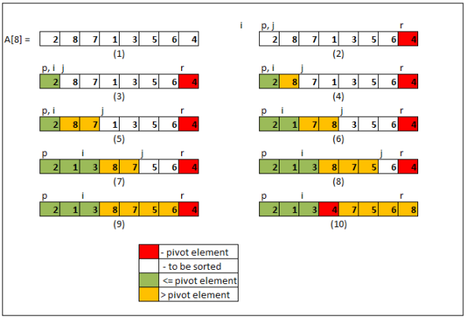
Example

Slide 10
Analysis of Quick Sort
Assumptions:
  A random pivot (no median-of-three partitioning)
  No cutoff for small arrays
Running time
  pivot selection: constant time, i.e. O(1)
  partitioning: linear time, i.e. O(N)
  running time of the two recursive calls
  T(N)=T(i)+T(N-i-1)+cN where c is a constant
    i: number of elements in S1
For very small arrays, quicksort does not perform as well as insertion sort
  how small depends on many factors, such as the time spent making a recursive call, the compiler, etc
Do not use quicksort recursively for small arrays
  Instead, use a sorting algorithm that is efficient for small arrays, such as insertion sort

Slide 11
Picking the Pivot
Use the first element as pivot
  if the input is random, ok
  if the input is presorted (or in reverse order)
    all the elements go into S2 (or S1)
    this happens consistently throughout the recursive calls
    Results in O(n²) behavior (Analyze this case later)
Choose the pivot randomly
  generally safe
  random number generation can be expensive
Use the median of the array
  Partitioning always cuts the array into roughly half
  An optimal quicksort (O(N log N))
  However, hard to find the exact median
    e.g., sort an array to pick the value in the middle

Slide 12
Good Luck ! ☻

