Slide 1
Fundamentals of Algorithms
MCS - 2
Lecture # 17

Slide 2
Binary Search Trees

Slide 3
BST: Definition
In computer science, a binary search tree (BST), sometimes also called an ordered or sorted binary tree, is a node-based binary tree data structure which has the following BST properties
The left subtree of a node contains only nodes with keys less than the node's key.
The right subtree of a node contains only nodes with keys greater than the node's key.
The left and right subtree each must also be a binary search tree.
There must be no duplicate nodes.
BST Property
For all nodes x and y,
  if y belongs to the left subtree of x, then the key at y is less than the key at x, and
  if y belongs to the right subtree of x, then the key at y is greater than the key at x.

Slide 4
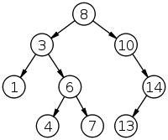
Parts of a binary tree
A binary search tree of size 9 and depth 3, with root 8 and leaves 1, 4, 7 and 13
A binary tree is composed of zero or more nodes
Each node contains
  A value (some sort of data item)
  A reference or pointer to a left child (may be null), and
  A reference or pointer to a right child (may be null)
A binary tree may be empty (contain no nodes)
If not empty, a binary tree has a root node
  Every node in the binary tree is reachable from the root node by a unique path
A node with neither a left child nor a right child is called a leaf.

Slide 5
Size and depth of BST
The size of a binary tree is the number of nodes in it
  This tree has size 12
The depth of a node is its distance from the root
  l is at depth zero
  e is at depth 2
The depth of a binary tree is the depth of its deepest node
  This tree has depth 4
a
b
c
d
e
f
g
h
i
j
k
l

Slide 6
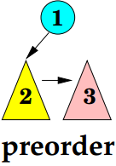
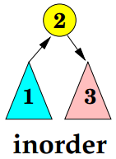
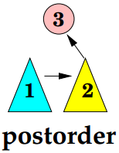
Traversal / Walk of the Nodes in a BST
Traversal means visiting all the nodes in a graph.
There are three traversal strategies.
Preorder
  The ordering is: the current node, the left subtree, the right subtree.
Inorder
  The ordering is: the left subtree, the current node, the right subtree.
Postorder
  The ordering is: the left subtree, the right subtree, the current node.

Slide 7
BST Traversals using “Flags”
The order in which the nodes are visited during a tree traversal can be easily determined by imagining there is a “flag” attached to each node, as follows:
To traverse the tree, collect the flags:
preorder
inorder
postorder
A
A
A
B
C
B
C
B
C
D
E
F
G
D
E
F
G
D
E
F
G
A B D E C F G
D B E A F C G
D E B F G C A

Slide 8
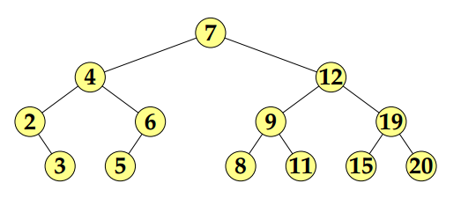
Example
What is the outcome of inorder, postorder and preorder traversal on this BST?
Inorder traversal gives
  2, 3, 4, 5, 6, 7, 8 , 9, 11, 12, 15,19, 20
Preorder traversal gives
  7, 4, 2, 3, 6, 5, 12, 9, 8, 11, 19, 15, 20
Postorder traversal gives
  3, 2, 5, 6, 4, 8, 11, 9, 15, 20, 19, 12, 7

Slide 9
In-order BST Traversal Pseudo code
INORDER-TREE-WALK(x)
1 if x ≠ NIL
2 then INORDER-TREE-WALK ( left [x] )
3 print key [x]
4 INORDER-TREE-WALK ( right [x] )
Running time
Θ(n), where n is the size of the tree rooted at x

Slide 10
Operations on BST
  Search(S,k)
  Insert(S,x)
  Delete(S,x)
  Minimum or Maximum(S)
  Successor or Predecessor (S,x)
  List All(S)
  Merge(S₁,S₂)

Slide 11
BST Search Pseudo code
Here k is the key that is searched for and x is the start node.
TREE-SEARCH(x, k)
1 if x = NIL or k = key [x]
2 then return x
3 if k < key [x]
4 then return TREE-SEARCH(left [x], k )
5 else return TREE-SEARCH(right [x], k )
Running time: O(h), h – height of tree

Slide 12
Good Luck ! ☻

