Slide 1
Fundamentals of Algorithms
MCS - 2
Lecture # 17

Slide 2
Binary Search Trees

Slide 3
BST Finding Maximum Pseudo code
Following right child pointers from the root, until a NIL is encountered.
TREE-MAXIMUM(x)
1 while right [x] ≠ NIL
2 do x ← right [x]
3 return x
Running time: O(h), h – height of tree

Slide 4
BST Finding Minimum Pseudo code
Following left child pointers from the root, until a NIL is encountered.
TREE-MINIMUM(x)
1 while left [x] ≠ NIL
2 do x ← left [x]
3 return x
Running time: O(h), h – height of tree

Slide 5
BST Insertion Pseudo code
Suppose that we need to insert a node z such that k = key[z]. Using binary search we find a nil such that replacing it by z does not break the BST-property.
If key [x] < v move to the right child of x, else move to the left child of x
When x is NIL, we found the correct position
If v < key [y] insert the new node as y’s left child, else insert it as y’s right child
TREE-INSERT(T, z)
1 y ← NIL
2 x ← root [T]
3 while x ≠ NIL
4 do y ← x
5 if key [z] < key [x]
6 then x ← left [x]
7 else x ← right [x]

Slide 6
BST Insertion Pseudo code
8 p[z] ← y
9 if y = NIL
10 then root [T] ← z // Tree T was empty
11 else if key [z] < key [y]
12 then left [y] ← z
13 else right [y] ← z
Running time: O(h), h – height of tree

Slide 7
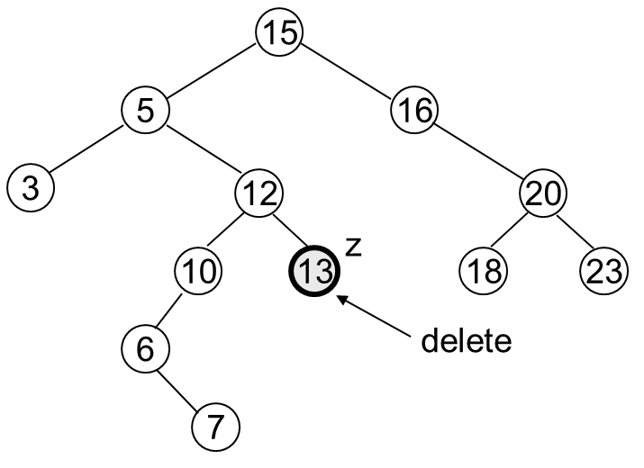
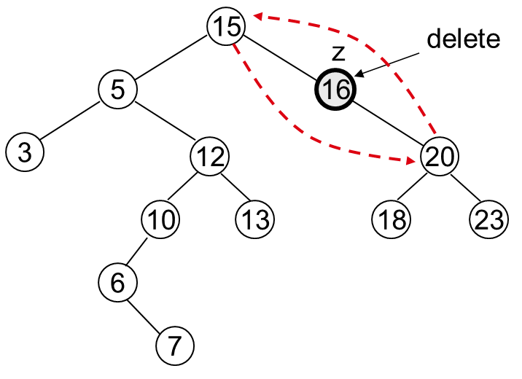
BST Deletion
Delete a given node z from a binary search tree
Case 1: z has no children
  Delete z by making the parent of z point to NIL
Case 2: z has one child
  Delete z by making the parent of z point to z’s child, instead of to z

Slide 8
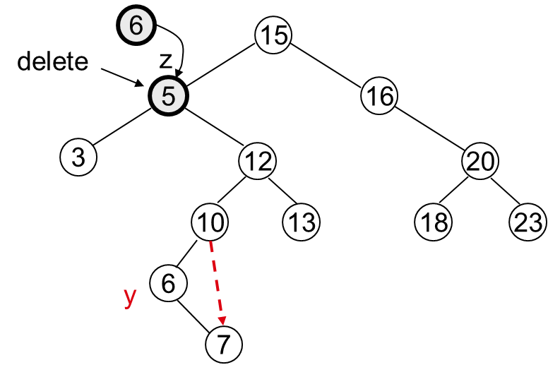
BST Deletion Pseudo code
Case 3: z has two children
  z’s successor (y) is the minimum node in z’s right subtree
  y has either no children or one right child (but no left child)
  Delete y from the tree (via Case 1 or 2)
  Replace z’s key and satellite data with y’s.
  TREE-DELETE(T, z)
  1 if left[z] = NIL or right[z] = NIL
  2 then y ← z // if z has one child
  3 else y ← TREE-SUCCESSOR(z) // if z has two children
  4 if left[y] ≠ NIL
  5 then x ← left[y]
  6 else x ← right[y]

Slide 9
BST Deletion Pseudo code (Cont.)
7 if x ≠ NIL
8 then p[x] ← p[y]
9 if p[y] = NIL
10 then root[T] ← x
11 else if y = left[p[y]]
12 then left[p[y]] ← x
13 else right[p[y]] ← x
14 if y ≠ z
15 then key[z] ← key[y]
16 copy y’s satellite data into z
17 return y
  Running time: O(h)

Slide 10
BST Height Pseudo code
Let x be the root node of a binary search tree (BST).
BST-Height(x)
1 if x=NIL
2 return -1;
3 else return max (BST-Height(left[x]), BSTHeight(right[x]))+1;

Slide 11
Good Luck ! ☻

