Slide 1
Fundamentals of Algorithms
MCS - 2
Lecture # 5

Slide 2
Representation of Algorithms (continued)
Flowcharts

Slide 3
Pseudo code Example
Write an algorithm to determine a student’s final grade and indicate whether it is passing or failing. The final grade is calculated as the average of four marks.
Pseudo code
Input a set of 4 marks
Calculate their average by summing and dividing by 4
if average is below 60
Print “FAIL”
else
Print “PASS”

Slide 4
Detailed Algorithm
Step 1: Input M1,M2,M3,M4
Step 2: GRADE ← (M1+M2+M3+M4) / 4
Step 3: if (GRADE < 60) then
Print “FAIL”
else
Print “PASS”
endif

Slide 5
Definition of Flowchart
A flowchart is a type of diagram that represents an algorithm or process, showing the steps as boxes of various kinds, and their order by connecting them with arrows.
A flowchart
shows logic solution,
emphasizes individual steps and their interconnections,
A flowchart must have a start and stop,
A steps in a flowchart must connect. Can’t leave a step “hanging” with no connection.

Slide 6
Flow Charts
Flowcharts are a graphical means of representing an algorithm.
Advantages
  Flowchart permit the structure of a program to be easily visualized - even if all the text were to be removed.
  The human brain is very good at picking out these patterns and keeping them "in the back of the mind" as a reference frame for viewing the code as it develops.

Slide 7
Basic Flowchart Shapes
Terminal symbol - indicates the beginning and
end points of an algorithm.
Process symbol - shows an instruction other than
input, output or selection.
Input-output symbol - shows an input or an output
operation.
Disk storage I/O symbol - indicates input from or output to disk storage.

Slide 8
Basic Flowchart Shapes
Selection symbol - shows a selection process
for two-way selection.
Off-page connector - provides continuation of a logical path on another page.
On-page connector - provides continuation
of logical path at another point in the same
page.
Flow lines - indicate the logical sequence of
execution steps in the algorithm.

Slide 9
Flowchart – sequence control structure
Statement 1
Statement 2
Statement 3
:

Slide 10
Flowchart – selection control structure
Pseudocode
IF: (test condition)
Statement TRUE
ELSE:
Statement FALSE
No
Yes
Condition
else-
statement(s)
then-
statement(s)

Slide 11
Flowchart – repetition control structure
yes
Loop
Statement(s)
Condition
no

Slide 12
Flowchart – example 1
Begin
Pseudocode
GET Birth Year
SET age= Current year- Birth Year
PUT Age
Read birth date
Calculate
Age = current year – birth date
Display
age
End

Slide 13
Flowchart – example 2
Begin
Read age
YES
Age > 55?
NO
print “Pencen”
print “Kerja lagi”
End

Slide 14
Flowchart – example 5
Begin
sum = 0
current_number = 1
NO
current_number <= 10?
print sum
YES
sum = sum + current_number
current_number = current_number + 1
End

Slide 15
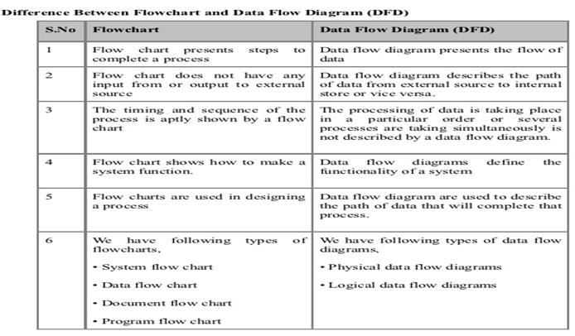
assignment # 2
Write an algorithm to calculate the sum of the digits of a three digit number.
  Trace the algorithm using the number 659.
Write an algorithm to calculate the average mark out of 100, given three assignment marks, each of which is marked out of 20.
  Trace the algorithm using 15, 20 and 10 as the three assignment marks.
Write an algorithm to sum four numbers and return the sum in the variable x.
  Trace the algorithm using w as 2, x as 3, y as 4 and z as 5.

Slide 16
Good Luck ! ☻

