Slide 1
Fundamentals of Algorithms
MCS - 2
Lecture # 8

Slide 2
Growth of Functions

Slide 3
Measuring Performance of Algorithms
Most algorithms are designed to work with inputs of arbitrary length. Usually, the efficiency or running time of an algorithm is stated as a function relating the input length to the number of steps (time complexity) or storage locations (space complexity).
There are two aspects of algorithmic performance
Time
  Instructions take time.
  How fast does the algorithm perform?
  What affects its runtime?
Space
  Data structures take space
  What kind of data structures can be used?
  How does choice of data structure affect the runtime?
Algorithms can not be compared by running them on computers. Run time is system dependent.
Even on same computer would depend on language.

Slide 4
Time Complexity of Algorithms
The goal of time complexity (computational complexity) is to classify algorithms according to their performances.
The time complexity of an algorithm quantifies the amount of time taken by an algorithm to run as a function of the length of the string representing the input.
Time complexity is commonly estimated by counting the number of elementary operations performed by the algorithm, where an elementary operation takes a fixed amount of time to perform.
Complexity is defined as a numerical function T(n) - time versus the input size n.

Slide 5
Time Complexity of Algorithms
A: an Algorithm
I: an input to A
T(I): Total instructions executed on input I
|L|: length of I
Best case time complexity: minimum time on all input of size n
Worst case time complexity: maximum time on all input of size n
Average case time complexity: average time on all input of size n
T(n)=max{T(I): I is an input of size n}

Slide 6
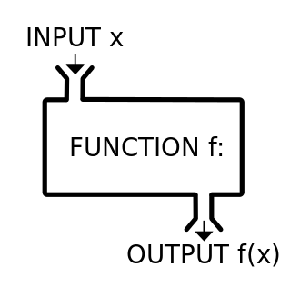
What is Function?
In mathematics, a function is a relation between a set of inputs and a set of permissible outputs with the property that each input is related to exactly one output.
For example a function that relates each real number x to its square x². The output of a function f corresponding to an input x is denoted by f(x) (read "f of x").
The input to a function is called the argument and the output is called the value. The set of all permitted inputs to a given function is called the domain of the function, while the set of permissible outputs is called the codomain.
There are many ways to describe or represent a function.
  Some functions may be defined by a formula or algorithm that tells how to compute the output for a given input.
  Others are given by a picture, called the graph of the function.
  In science, functions are sometimes defined by a table that gives the outputs for selected inputs.

Slide 7
Function Notation
A function f with domain X and codomain Y is commonly denoted by
Or
In this context, the elements of X are called arguments of f. For each argument x, the corresponding unique y in the codomain is called the function value at x or the image of x under f. It is written as f(x). One says that f associates y with x or maps x to y. This is abbreviated by
A general function is often denoted by f.
Formulas and algorithms
  Different formulas or algorithms may describe the same function.
  For instance f(x) = (x + 1) (x − 1) is exactly the same function as f(x) = x² − 1.

Slide 8
Growth / Order of Function

Slide 9
Asymptotic Notations
To judge how long two solutions will take to run, and choose the better of the two, you don't need to know how many minutes and seconds they will take, but you do need some way to compare algorithms against one another.
Asymptotic notation is a way of expressing the main component of the cost of an algorithm.
Its domain is the set of natural numbers N={0,1,2,….}
Such notations are convenient for describing the worst-case running-time function T(n), which is usually defined only on integer input sizes.
Example
  f(n) = Θ(n²).
  Describes how f(n) grows in comparison to n².
Theta (Θ) notation
Big O (Ο) notation
  Little o (o) notation
Big Omega (Ω) notation
  Little Omega (ω) notation

Slide 10
Classifying Functions by Their Asymptotic Growth
Asymptotic growth
  The rate of growth of a function
Given a particular differentiable function f(n), all other differentiable functions fall into three classes.
Growing with the same rate
Growing faster
Growing slower

Slide 11
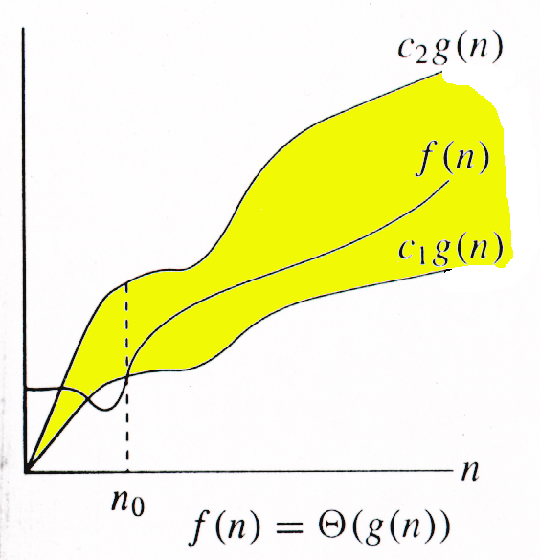
Theta (Θ) notation
For non-negative functions, f(n) and g(n),
f(n) and g(n), f(n) is theta of g(n) if and only if
f(n) = O(g(n)) and f(n) = Ω(g(n)).
f(n) is theta of g(n) and it is denoted as "f(n) = Θ(g(n))".
For function g(n), we define Θ(g(n)), big-Theta of n,
as the set g(n) is an asymptotically tight bound for f(n).
Basically the function, f(n) is bounded both from the top and bottom by the same function, g(n).

Slide 12
Theta (Θ) notation
Examples
  2 n = Θ(n)
  n² + 2 n + 1 = Θ( n²)
Rate of growth, if
  lim( f(n) / g(n) ) = c,
  0 < c < ∞, n -> ∞

Slide 13
Good Luck ! ☻

