Slide 1
Fundamentals of Algorithms
MCS - 2
Lecture # 9

Slide 2
Asymptotic Notations

Slide 3
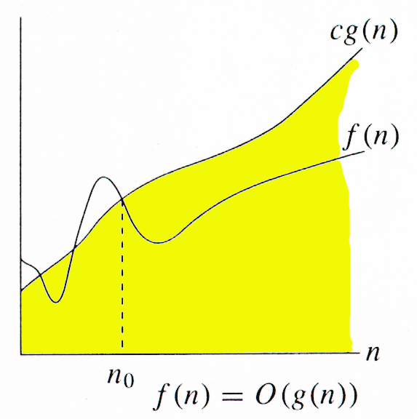
Big Oh / O Notation
O-notation is used to state only the asymptotic upper bounds.
The function f(n) is O(g(n)) If,
  there exist a positive real constant c and a positive integer n₀
  such that f(n) ≤ cg(n) for all n > n₀
It is pronounced as f(n) is Big Oh of g(n))
Intuitively: Set of all functions whose rate of growth is the same as or lower than that of g(n).
So f(n) = O(g(n)), if f(n) grows with same rate or slower than g(n).
g(n) is an asymptotic upper bound for f(n).
Beyond some certain point (n₀), and when n becomes very large, g(n) will always be greater than f(n). So here f(n) is called UPPER BOUNDING FUNCTION.

Slide 4
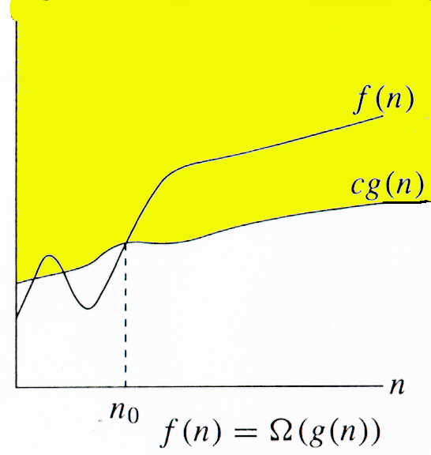
Big Omega / Ω -Notation
Ω -notation is used to state only the asymptotic lower bounds.
The function f(n) is Ω(g(n)) If,
  there exist a positive real constant c and a positive integer n₀
  such that f(n) ≥ cg(n) for all n > n₀
It is pronounced as f(n) is Big Omega of g(n))
Intuitively: Set of all functions whose rate of growth is the same as or greater than that of g(n).
So f(n) = Ω(g(n)), if f(n) grows with same rate or higher than g(n)
g(n) is an asymptotic lower bound for f(n).
Beyond some certain point (n₀), and when n becomes very large, g(n) will always be less than f(n). So here f(n) is called LOWER BOUNDING FUNCTION.
Ω is the inverse of / complementary to Big-Oh.

Slide 5
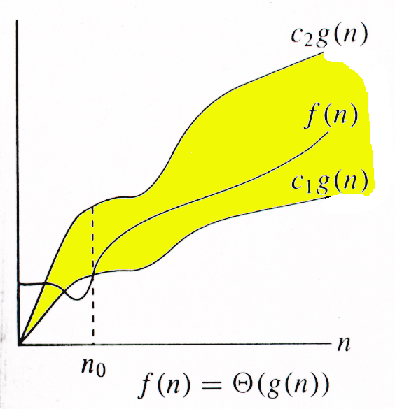
Theta (Θ) notation
For non-negative functions, f(n) and g(n),
f(n) is theta of g(n) if and only if
f(n) = O(g(n)) and f(n) = Ω(g(n)).
f(n) is theta of g(n) and it is denoted as "f(n) = Θ(g(n))".
For function g(n), we define Θ(g(n)), big-Theta of n,
as the set g(n) is an asymptotically tight bound for f(n).
Basically the function, f(n) is bounded both from the top and bottom by the same function, g(n).
if f(n) is Θ(g(n)) then both the functions have the same rate of growth.
Beyond some certain point (n₀), and when n becomes very large, f(n) and g(n) will always be equivalent in some sense. So here f(n) is called ORDER FUNCTION.
n₀ is minimum possible value

Slide 6
3 Notations
Big-O notation
O(g(n))= { f(n) | there exist positive constants c and n₀
such that 0 ≤ f(n) ≤ cg(n)
For all n ≥ n₀ }
Big-Ω notation
Ω(g(n))= { f(n) | there exist positive constants c and n₀
such that 0 ≥ f(n) ≥ cg(n)
For all n ≥ n₀ }
Θ notation
Θ(g(n))= { f(n) | there exist positive constants c₁,c₂ and n₀
such that 0 ≤ c₁g(n) ≤ f(n) ≤ c₂g(n)
For all n ≥ n₀ }

Slide 7
More Notations
There are also small-oh and small-omega (ω) notations representing loose upper and loose lower bounds of a function.
f(x) = o(g(x)) (small-oh) means that the growth rate of f(x) is asymptotically less than the growth rate of g(x).
f(x) = ω(g(x)) (small-omega) means that the growth rate of f(x) is asymptotically greater than the growth rate of g(x)
f(x) = Θ(g(x)) (theta) means that the growth rate of f(x) is asymptotically equal to the growth rate of g(x)

Slide 8
Good Luck ! ☻

