Slide 1
Introduction to .NET Framework
Tahir Nawaz

Slide 2
.NET – What Is It?
Software platform
Language neutral
In other words:
  .NET is not a language (Runtime and a library for writing and executing written programs in any compliant language)

Slide 3
What Is .NET
.Net is a new framework for developing web-based and windows-based applications within the Microsoft environment.
The framework offers a fundamental shift in Microsoft strategy: it moves application development from client-centric to server-centric.

Slide 4
.NET – What Is It?
.NET Application
.NET Framework
Operating System + Hardware

Slide 5
Framework, Languages, And Tools
VB
VC++
VC#
JScript
…
Visual Studio.NET
Common Language Specification
ASP.NET: Web Services
and Web Forms
Windows
Forms
ADO.NET: Data and XML
Base Class Library
Common Language Runtime

Slide 6
The .NET Framework
.NET Framework Services
Common Language Runtime
Console Applications
Windows® Forms
  Windows Forms
  Windows Services
ASP.NET
  Web Forms
  Web Services
ADO.NET, evolution of ADO
Visual Studio.NET

Slide 7
Common Language Runtime (CLR)
CLR works like a virtual machine in executing all languages.
All .NET languages must obey the rules and standards imposed by CLR. Examples:
  Object declaration, creation and use
  Data types,language libraries
  Error and exception handling
  Interactive Development Environment (IDE)

Slide 8
Common Language Runtime
Development
  Mixed language applications
    Common Language Specification (CLS)
    Common Type System (CTS)
    Standard class framework
    Automatic memory management
  Consistent error handling and safer execution
  Potentially multi-platform
Deployment
  Removal of registration dependency
  Safety – fewer versioning problems

Slide 9
Common Language Runtime
Multiple Language Support
CTS is a rich type system built into the CLR
  Implements various types (int, double, etc)
  And operations on those types
CLS is a set of specifications that language and library designers need to follow
  This will ensure interoperability between languages

Slide 10
Compilation in .NET
Code in VB.NET
Code in C#
Code in another
.NET Language
VB.NET compiler
C# compiler
Appropriate
Compiler
IL(Intermediate
Language) code
CLR just-in-time
execution

Slide 11
Intermediate Language (IL)
.NET languages are not compiled to machine code. They are compiled to an Intermediate Language (IL).
CLR accepts the IL code and recompiles it to machine code. The recompilation is just-in-time (JIT) meaning it is done as soon as a function or subroutine is called.
The JIT code stays in memory for subsequent calls. In cases where there is not enough memory it is discarded thus making JIT process interpretive.

Slide 12
Languages
Languages provided by MS
  VB, C++, C#, J#, JScript
Third-parties are building
  APL, COBOL, Pascal, Eiffel, Haskell, ML, Oberon, Perl, Python, Scheme, Smalltalk…

Slide 13
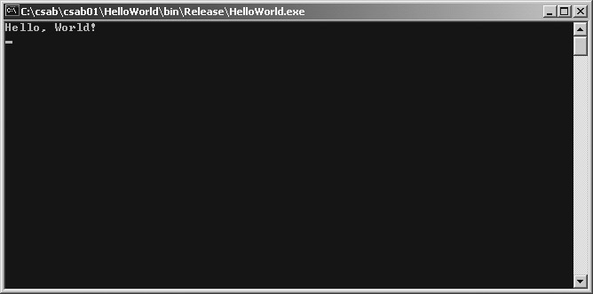
Application Types
Console Application
  Has standard streams (out, in, exception)
  No Visual Components

Slide 14

Windows Application
  GUI based
  No standard streams (out, in, exception)
  Main thread is shared by the GUI message pump & your code

Slide 15
Windows Forms
Framework for Building Rich Clients
  RAD (Rapid Application Development)
  Rich set of controls
  Data aware
  ActiveX® Support
  Licensing
  Accessibility
  Printing support
  Unicode support
  UI inheritance

Slide 16
ASP.NET
ASP.NET the platform services that allow to program Web Applications and Web Services in any .NET language
ASP.NET Uses .NET languages to generate HTML pages. HTML page is targeted to the capabilities of the requesting Browser
ASP.NET “Program” is compiled into a .NET class and cached the first time it is called. All subsequent calls use the cached version.

Slide 17
ASP.NET
Logical Evolution of ASP
  Supports multiple languages
  Improved performance
  Control-based, event-driven execution model
  More productive
  Cleanly encapsulated functionality

Slide 18
ASP.NET Web Forms
Allows clean cut code
  Code-behind Web Forms
Easier for tools to generate
Code within is compiled then executed
Improved handling of state information
Support for ASP.NET server controls
  Data validation
  Data bound grids

Slide 19
ASP.NET Web Services
A technical definition
  “A programmable application component accessible via standard Web protocols”

Slide 20
Web Services
It is just an application…
…that exposes its features and capabilities over the network…
…using XML…
…to allow for the creation of powerful new applications that are more than the sum of their parts…

Slide 21
ADO.NET
(Data and XML)
New objects (e.g., DataSets)
Separates connected / disconnected issues
Language neutral data access
Uses same types as CLR
Great support for XML

Slide 22
ADO .NET
ADO.NET is an improvement to Microsoft ADO that provides platform interoperability and scalable data access.
Using Extensible Markup Language (XML), ADO.NET can ensure the efficient transfer of data to any application on any platform.
1/2

Slide 23
ADO
Stands for “ActiveX Data Objects”
Microsoft technology for access to remote data via Internet.

Slide 24
ADO .NET
The centerpiece of ADO.NET is the data set.
A data set is an in-memory copy of database data.
A data set constitutes a "disconnected" view of the database data.
It exists in memory without an active connection to a database containing the corresponding tables or views.

Slide 25
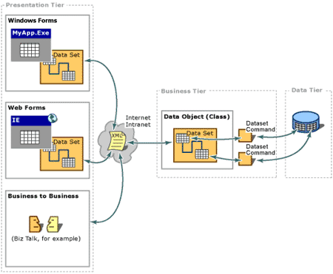
ADO .NET

Slide 26
ADO .NET characteristic
New data access technology
Designed for disconnected operation
Optimized for data viewing
XML based
Increased flexibility
Increased readability of code
No real change from a developer's perspective.

Slide 27
Visual Studio.NET
Development tool that contains a rich set of productivity and debugging features

Slide 28
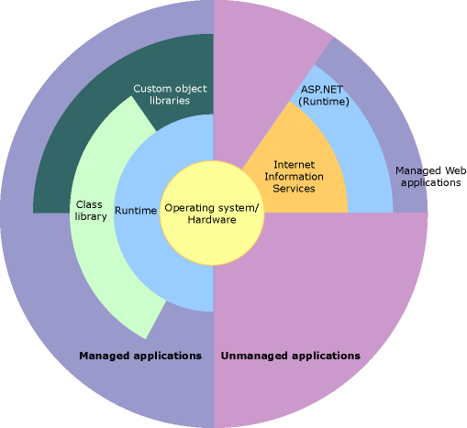
.NET – Hierarchy, Another View
CLR
CLR

Slide 29
Summary
The .NET Framework
  Dramatically simplifies development and deployment
  Provides robust and secure execution environment
  Supports multiple programming languages

