Slide 1
Object Oriented Paradigm
OOP’s

Slide 2
Problems with Structured Programming
As programs grow ever larger and more complex, even the structured programming
approach begins to show signs of strain.
The project is too complex,
the schedule slips,
more programmers are required,
complexity increases,
costs increases like rocket,
the schedule slips further, and disaster ensues.
Analyzing the reasons for these failures reveals that there are weaknesses in the procedural
paradigm itself.
No matter how well the structured programming approach is implemented,
large programs become excessively complex.

Slide 3
What are the reasons for these problems with procedural languages?
There are two related problems.
First, functions have unrestricted access to global data.
Second, unrelated functions and data, the basis of the procedural paradigm, provide a poor model of the real world.
e.g. these problems in the context of an inventory program.
One important global data item in such a program is the collection of items in the inventory. Various functions access this data to input a new item, display an item, modify an item, and so on.

Slide 4
Unrestricted Access
In a procedural program, for e.g. one written in C Language
  There are two kinds of data.
Local data is hidden inside a function, and is used exclusively by the function.
  In the inventory program a display function might use local data to remember which item it was displaying. Local data is closely related to its function and is safe from modification by other functions.
However, when two or more functions must access the same data—and this is true of the most important data in a program—then the data must be made global, as our collection of inventory items is.
Global data can be accessed by any function in the program. The arrangement of local and global variables in a procedural program is shown.

Slide 5
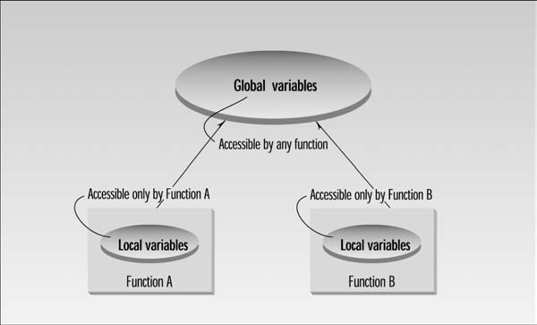

Slide 6
In a large program, there are many functions and many global data items.
The problem with the procedural paradigm is that this leads to an even larger number of potential connections between functions and data, as shown
This large number of connections causes problems in several ways.
First, it makes a program’s structure difficult to conceptualize. Second, it makes the program difficult to modify.
A change made in a global data item may necessitate rewriting all the functions that access that item.

Slide 7
e.g.
  in our inventory program, someone may decide that the product codes for the inventory items should be changed from 5 digits to 12 digits.
This cause the need to change from a short to a long data type.
  Now all the functions that operate on the data must be modified to deal with a long instead of a short.

Slide 8
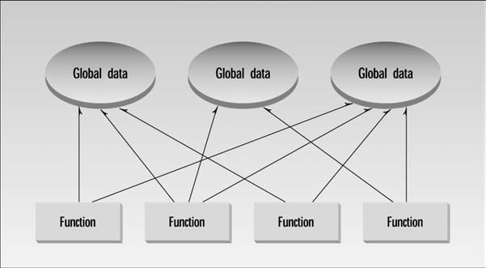

Slide 9
Real-World Modeling
  The second—and more important—problem with the procedural paradigm is that its arrangement of separate data and functions does a poor job of modeling things in the real world.
  In the physical world we deal with objects such as people and cars. Such objects aren’t like data and they aren’t like functions. Complex real-world objects have both attributes and behavior.
Attributes
  Examples of attributes (sometimes called characteristics) are, for people, eye color and job title; and, for vehicles etc As it turns out, attributes in the real world are equivalent to data in a program: they have a certain specific values, such as blue or four.
Behavior
  Behavior is something a real-world object does in response to some stimulus. If anyone ask his boss for a raise, He/she will generally say yes/no.
  If you apply the brakes in a car, it will generally stop. Saying something and stopping are examples of behavior.
  Behavior is like a function: you call a function to do something and it does it.

Slide 10
The Object-Oriented Approach
  The fundamental idea behind object-oriented languages is to combine into a single unit both data and the functions that operate on that data. Such a unit is called an Object.
An object’s functions, called member functions in C++, typically provide the only way to access its data. If you want to read a data item in an object, you call a member function in the object. It will access the data and return the value to you. You can’t access the data directly.
The data is hidden, so it is safe from accidental alteration. Data and its functions are said to be encapsulated into a single entity. Data encapsulation and data hiding are key terms in the description of object-oriented languages.

Slide 11
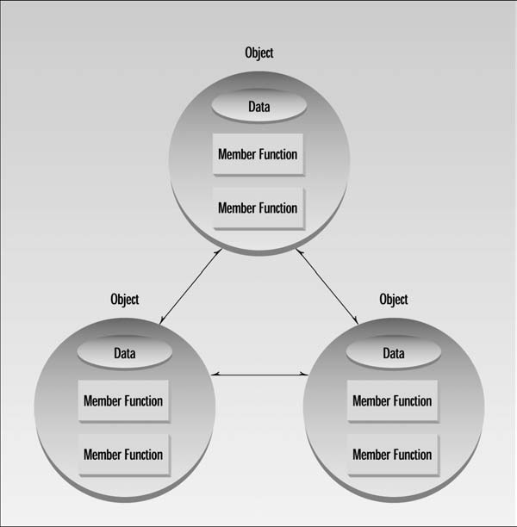

Slide 12
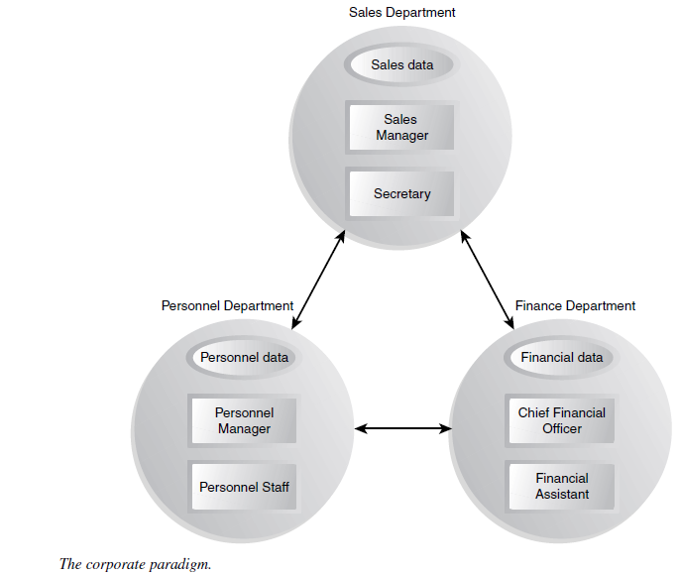

Slide 13
Reusability
  Once a class has been written, created, and debugged, it can be distributed to other programmers for use in their own programs.
  This is called reusability. It is similar to the way a library of functions in a procedural language can be incorporated into different programs.

Slide 14

What is Object Oriented Programming?
Identifying objects and assigning responsibilities to these objects.
Objects communicate to other objects by sending messages.
Messages are received by the methods of an object
An object is like a black box.
The internal details are hidden.

Slide 15



What is an object?
Tangible Things as a car, printer, ...
Roles as employee, boss, ...
Interactions as contract, sale, ...
Specifications as colour, shape, …

Slide 16
Object Oriented Programming
Programmer who defines the attributes and behavior of objects
Objects are modeled according to real-world entities
Different approach from structure programming such as C language

Slide 17
Object Oriented Programming
Object-oriented programming (OOP)
  Encapsulates data (attributes) and functions (behavior) into packages named classes.
Classes are user-defined types.
  Data Members
  Member Functions or Methods)

Slide 18
Reasons for OOP
  Simplify programming
  Interfaces
    Information hiding:
      Implementation details hidden within classes themselves
  Software reuse
    Class objects included as members of other classes

Slide 19
Classes in C++
A class definition begins with the keyword class.
The body of the class is contained within a set of braces, { } ; (notice the semi-colon).
class class_name
{
….
….
….
};
Any valid identifier
Class body (data member +Function)

Slide 20
Classes C++
Within the body, the keywords private: and public: specify the access level of the members of the class.
  Default is private
Usually, the data members of a class are declared in the private: section of the class and the member functions are in public: section

Slide 21
Classes in C++
class class_name
{
private:
…
…
…
public:
…
…
…
};
private members or methods
Public members or methods

