Slide 1
Case Study: Safe Home Security System
Lecture Number 19 and 20.
Presented By:
Fahim khan
Assistant Professor

Slide 2
Introduction
This document describes the design of the Safe-Home system.
Many parts of the Safe-Home design, and the process used to develop it.
A software model can be produced at many different levels of abstraction. The model presented here is at an intermediate level: It includes diagrams relating the important hardware units, classes, and states.

Slide 3
Key actors and use cases
As a first step in development, however, we will identify the use cases that should be available in the first few releases – these will provide very basic security functionality.
There are two main actors (roles played by users of the system): HouseholdUser and ConfigurationManager.
The latter is a sub-actor of the former since ConfigurationManagers can do everything that HouseholdUsers can.

Slide 4
Key actors and use cases
The Arm System and Disarm System use cases both require the actor to specify an activation code.
The latter is shown as an inclusion use case. The use cases performed by the Configuration manager require a more sophisticated Log-In use case to be performed.

Slide 5
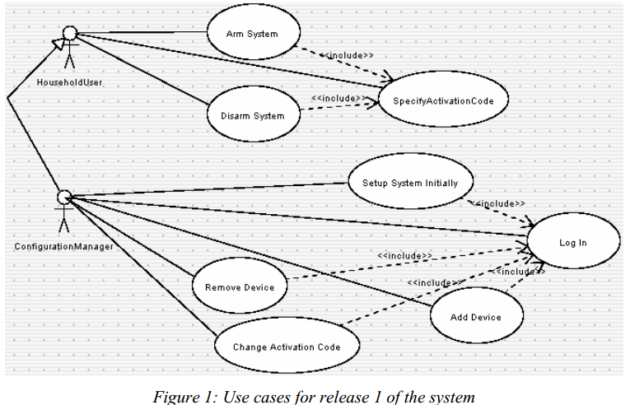
Key actors and use cases

Slide 6
Key actors and use cases
Some additional use cases that will need to be implemented in order to provide the functionality of changing configurations of the system. For simplicity we have not shown the fact that each of these also includes the Log-In use case.
There will also be a set of use cases for designing a room layout. These are not included for the time being.

Slide 7
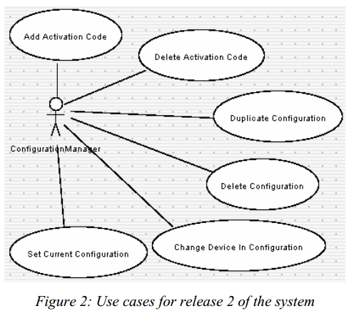
Key actors and use cases

Slide 8
Safe Home Architectural Model
The SafeHome model is arranged into a hierarchy of packages to help organize it.
Each of the elements in the remaining sections of this document is arranged into one of the packages shown.
There is also a conceptual outer package, simply called SafeHome, that includes all of them.

Slide 9
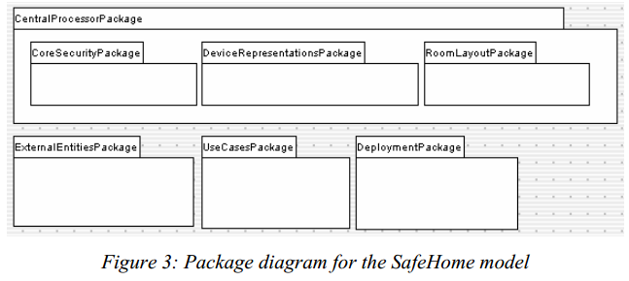
Safe Home Architectural Model

Slide 10
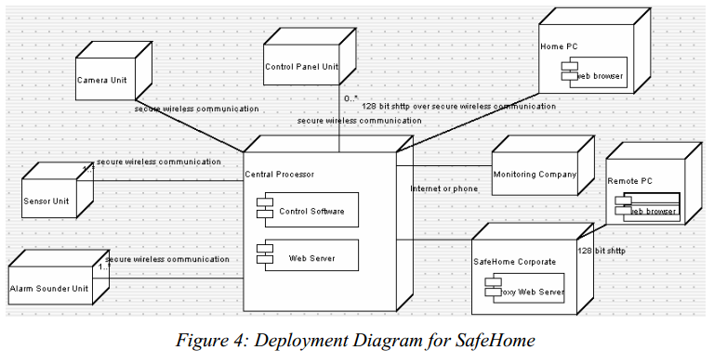
Hardware description

Slide 11
Control Software Classes
Figure 5 shows the core class diagram of the Control Software component. The classes in this diagram are described below.
SafeHomeSystem: The core singleton class (only one instance exists)
userid: Entered when logging into the system through a web browser.
streetAddress: Street address of the home. Used when communicating with the monitoring company to identify the property.

Slide 12
activationState: The state of the system as a whole.
masterPassword: A password that must be entered.
Configuration:
A setup of the system with various Devices (in zones), FloorPlans, and ActivationCodes.
There will always be at least one configuration – a configuration named ‘default’ is created when the system starts.

Slide 13
ConfigurationName: A name given to the configuration by the person setting up the configuration. Can be changed at any time.
ActivationCode: Contains a simple integer identifying a code that is typed to arm or disarm the system (Specify Activation Codeuse case). Different people can be given different codes, e.g. to allow a cleaner to enter temporarily (Add Activation Code use case). A future extension of the system would be to identify the time period during which certain codes are active.

Slide 14
DeviceType: Maintains information about each type of device that may be installed in the system. Each Device has a DeviceType – information that is common to all devices of the same type is kept here.
Device: A representation of particular piece of hardware installed in the system. A device is installed by telling the user interface thatit exists (specifying its serial number) and then powering it up (the Add Device use case).
serialNumber, label and isOn.

Slide 15
Sensor: Represents a device that should trigger a reaction by the system if some condition becomes true (a door is open, CO is detected, water is detected, motion is detected, fire is detected).
detectingAnomaly: True if the sensor is detecting the undesirable state it is designed to detect.
AlarmSignaler: Represents a device that will sound an alarm. There can be several subclasses.
Camera: Represents a camera that can send images to the system, and can be panned and zoomed.

Slide 16
Activity and state diagrams
In this section we will describe aspects the SafeHome system’s behavior.
When the SafeHome central processor is running, it must be able to do two things at once: Perform its main security monitoring functions and respond to configuration changes.

Slide 17
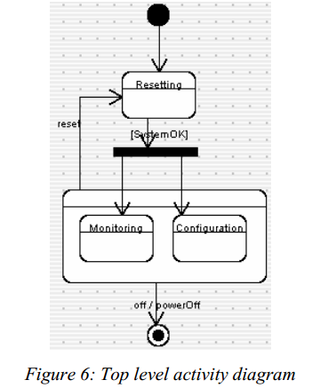
Activity and state diagrams

Slide 18
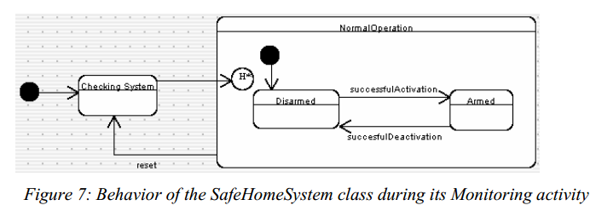
Behavioral diagram
There are three possible values for its activationState attribute: CheckingSystem, Disarmed and Armed; the latter two are substates of NormalOperation – in which the system spends most of its time.

Slide 19
State Diagram of the Armed State
In this state the system has to respond to sensors by triggering alarms. It starts off in the No Sensors Triggered sub state of the Nothing Unusual sub state. Everything is normal while it is in this sub state.
If a motion detector detects motion, no alarm is immediately sounded: The system requires more than a short period of motion to sound an alarm; the motion could be caused by the homeowner coming home and going through the process of deactivating the system at a control panel.

Slide 20
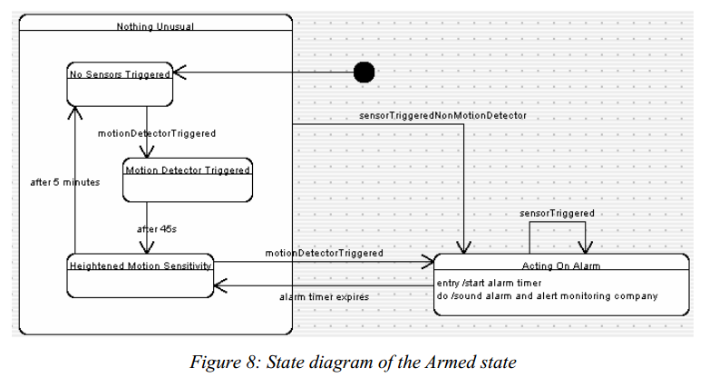
State Diagram of the Armed State

Slide 21
State Diagram of the Armed State
The user interface of a model of control panel that is used to arm or disarm the system.
there may be a web based interface that would allow remote arming of the system, or an interface that could be controlled by the monitoring company. No matter what user interface is used, it must at some point trigger the successful Activation and successful Deactivation transitions.

Slide 22
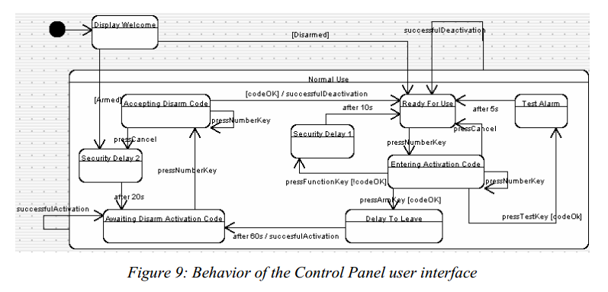
Behavior of the Control Panel user interface.

