Slide 1
Software Engineering
Lecture 7
Lecture # 7
Agile Software Development
Fahim Khan
Assistant Professor of Computer Science
UOL, Sargodha

Slide 2
Agility and the Cost of Change
Conventional wisdom is that the cost of change increases nonlinearly as a project progresses. It is relatively easy to accommodate a change when a team is gathering requirements early in a project. If there are any changes, the costs of doing this work are minimal. But if the middle of validation testing, a stakeholder is requesting a major functional change. Then the change requires a modification to the architectural design, construction of new components, changes to other existing components, new testing and so on. Costs escalate quickly.
A well-designed agile process may “flatten” the cost of change curve by coupling incremental delivery with agile practices such as continuous unit testing and pair programming. Thus team can accommodate changes late in the software project without dramatic cost and time impact.

Slide 3
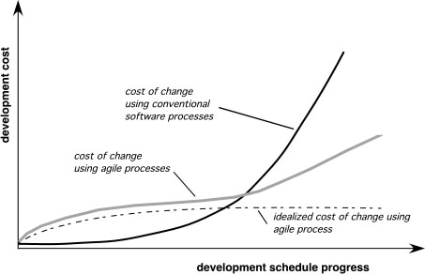
Agility and the Cost of Change

Slide 4
Human Factors
Proponents of agile software development take great pains to emphasize the importance of “people factors”.
Cockburn and Highsmith et al, states that, “Agile development focuses on the talents and skills of individuals, molding the process to specific people and teams”.
Competence:- inborn talent, software-related skills and overall knowledge of the process.
Common Focus:- all the team members must focus on one goal, to deliver a working software increment to the customer within the time promised.
they achieved this goal and will also focus on continual adaptations (small or large), which make the process fit to the needs of the team.
Collaboration: - they must collaborate with each other and also to other stake holders while creating information, helping them to perform the required task.
Decision-Making Ability:- team have the freedom to control its own destiny. The team must be autonomous while taking decision- making.
Self Organization: - serve to improve collaboration and boost team morale.

Slide 5
Human Factor
the process molds to the needs of the people and team, not the other way around
key traits must exist among the people on an agile team and the team itself:
  Competence. ( talent, skills, knowledge)
  Common focus. ( deliver a working software increment )
  Collaboration. ( peers and stakeholders)
  Decision-making ability. ( freedom to control its own destiny)
  Fuzzy problem-solving ability.(ambiguity and constant changes, today problem may not be tomorrow’s problem)
  Mutual trust and respect.
  Self-organization. ( themselves for the work done, process for its local

Slide 6
Agile method applicability
Product development where a software company is developing a small or medium-sized product for sale.
Custom system development within an organization, where there is a clear commitment from the customer to become involved in the development process and where there are not a lot of external rules and regulations that affect the software.
Because of their focus on small, tightly-integrated teams, there are problems in scaling agile methods to large systems.

Slide 7
Problems with agile methods
It can be difficult to keep the interest of customers who are involved in the process.
Team members may be unsuited to the intense involvement that characterizes agile methods.
Prioritizing changes can be difficult where there are multiple stakeholders.
Maintaining simplicity requires extra work.
Contracts may be a problem as with other approaches to iterative development.

Slide 8
Agile methods and software maintenance
Most organizations spend more on maintaining existing software than they do on new software development. So, if agile methods are to be successful, they have to support maintenance as well as original development.
Two key issues:
  Are systems that are developed using an agile approach maintainable, given the emphasis in the development process of minimizing formal documentation?
  Can agile methods be used effectively for evolving a system in response to customer change requests?
Problems may arise if original development team cannot be maintained.

Slide 9
Plan-driven and agile development
Plan-driven development:
  A plan-driven approach to software engineering is based around separate development stages with the outputs to be produced at each of these stages planned in advance.
  Not necessarily waterfall model
  plan-driven, incremental development is possible
  Iteration occurs within activities.
Agile development
  Specification, design, implementation and testing are inter-leaved and the outputs from the development process are decided through a process of negotiation during the software development process.

Slide 10
Plan-driven and agile specification

Slide 11
Technical, human, organizational issues
Most projects include elements of plan-driven and agile processes. Deciding on the balance depends on:
  Is it important to have a very detailed specification and design before moving to implementation? If so, you probably need to use a plan-driven approach.
  Is an incremental delivery strategy, where you deliver the software to customers and get rapid feedback from them, realistic? If so, consider using agile methods.
  How large is the system that is being developed? Agile methods are most effective when the system can be developed with a small co-located team who can communicate informally.
  This may not be possible for large systems that require larger development teams so a plan-driven approach may have to be used.

Slide 12
Technical, human, organizational issues
  What type of system is being developed?
    Plan-driven approaches may be required for systems that require a lot of analysis before implementation (e.g. real-time system with complex timing requirements).
  What is the expected system lifetime?
    Long-lifetime systems may require more design documentation to communicate the original intentions of the system developers to the support team.
  What technologies are available to support system development?
    Agile methods rely on good tools to keep track of an evolving design
  How is the development team organized?
    If the development team is distributed or if part of the development is being outsourced, then you may need to develop design documents to communicate across the development teams.

Slide 13
Technical, human, organizational issues
  Are there cultural or organizational issues that may affect the system development?
    Traditional engineering organizations have a culture of plan-based development, as this is the norm in engineering.
  How good are the designers and programmers in the development team?
    It is sometimes argued that agile methods require higher skill levels than plan-based approaches in which programmers simply translate a detailed design into code.
  Is the system subject to external regulation?
    If a system has to be approved by an external regulator (e.g. the FAA approve software that is critical to the operation of an aircraft) then you will probably be required to produce detailed documentation as part of the system safety case.

Slide 14
Extreme programming
Perhaps the best-known and most widely used agile method.
The ideas and methods associated with extreme programming occurred during 1980’s.
Extreme Programming (XP) takes an ‘extreme’ approach to iterative development.
  New versions may be built several times per day;
  Increments are delivered to customers every 2 weeks;
  All tests must be run for every build and the build is only accepted if tests run successfully.
XP Values: - Beck et al, defines five values which establish a foundation for all work performed as a part of XP.
- Communication:- Informal (verbal) collaboration (i.e., communication) b/w customers and developers.
- Simplicity :- restrict developers to design only for immediate needs, rather than consider future needs,
create a simple design which can be implemented easily.

Slide 15
XP and agile principles
Incremental development is supported through small, frequent system releases.
Customer involvement means full-time customer engagement with the team.
People not process through pair programming, collective ownership and a process that avoids long working hours.
Change supported through regular system releases.
Maintaining simplicity through constant refactoring of code.

Slide 16
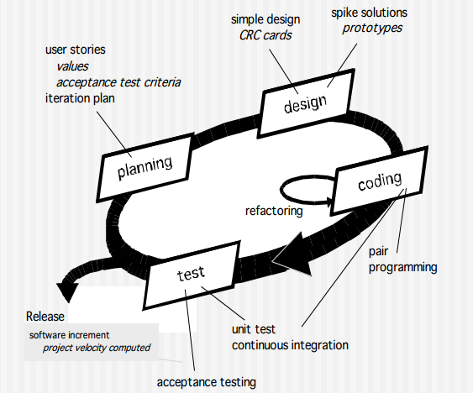
The XP Process

Slide 17
XP Planning
Begins with the listening, leads to creation of “user stories” that describes required output, features, and functionality. Customer assigns a value(i.e., a priority) to each story.
Agile team assesses each story and assigns a cost (development weeks. If more than 3 weeks, customer asked to split into smaller stories).
Working together, stories are grouped for a deliverable increment next release.
A commitment (stories to be included, delivery date and other project matters) is made. Three ways:
1. Either all stories will be implemented in a few weeks,
2. high priority stories first, or
3. the riskiest stories will be implemented first.
After the first increment “project velocity”, namely number of stories implemented during the first release is used to help define subsequent delivery dates for other increments. Customers can add stories, delete existing stories, change values of an existing story, split stories as development work proceeds.

Slide 18
XP Design
It occurs both before and after coding as refactoring is encouraged.
Follows the KIS principle (keep it simple) Nothing more nothing less than the story.
Encourage the use of CRC (class-responsibility-collaborator) cards in an object-oriented context. The only design work product of XP. They identify and organize the classes that are relevant to the current software increment.
For difficult design problems, suggests the creation of “spike solutions”—a design prototype for that portion is implemented and evaluated.
Encourages “refactoring”—an iterative refinement of the internal program design. Does not alter the external behavior yet improve the internal structure. Minimize chances of bugs. More efficient, easy to read.

Slide 19
Example of Refactoring
Re-organization of a class hierarchy to remove duplicate code.
Tidying up and renaming attributes and methods to make them easier to understand.
The replacement of inline code with calls to methods that have been included in a program library.

Slide 20
XP Coding
Recommends the construction of a unit test for a story before coding commences. So implementer can focus on what must be implemented to pass the test.
Encourages “pair programming”. Two people work together at one workstation. Real time problem solving, real time review for quality assurance. Take slightly different roles.
E.g., one person might think about the coding details of a particular portion of the design, while the other ensures the coding standards (a required part of XP) are being followed, or the developed code for the story will satisfy the unit test , to validate the code against the story.

Slide 21
Advantages of Pair Programming
It supports the idea of collective ownership and responsibility for the system.
  Individuals are not held responsible for problems with the code. Instead, the team has collective responsibility for resolving these problems.
It acts as an informal review process because each line of code is looked at by at least two people.
It helps support refactoring, which is a process of software improvement.
  Where pair programming and collective ownership are used, others benefit immediately from the refactoring so they are likely to support the process.

Slide 22
XP Testing
All unit tests are executed daily and ideally should be automated. Regression tests are conducted to test current and previous components.
“Acceptance tests” are defined by the customer and executed to assess customer visible functionality

Slide 23
The XP Debate
Requirements volatility: customer is an active member of XP team, changes to requirements are requested informally and frequently.
Conflicting customer needs: different customers' needs need to be assimilated. Different vision or beyond their authority.
Requirements are expressed informally: Use stories and acceptance tests are the only explicit manifestation of requirements. Formal models may avoid inconsistencies and errors before the system is built. Proponents said changing nature makes such models obsolete as soon as they are developed.
Lack of formal design: XP deemphasizes the need for architectural design. Complex systems need overall structure to exhibit quality and maintainability. Proponents said incremental nature limits complexity as simplicity is a core value.

Slide 24
Key Points
Agile methods are incremental development methods that focus on rapid development, frequent releases of the software, reducing process overheads and producing high-quality code. They involve the customer directly in the development process.
The decision on whether to use an agile or a plan-driven approach to development should depend on the type of software being developed, the capabilities of the development team and the culture of the company developing the system.
Extreme programming is a well-known agile method that integrates a range of good programming practices such as frequent releases of the software, continuous software improvement and customer participation in the development team

