Slide 1
Software Engineering
Lecture No:16.
Lecture # 7
CMMI
Fahim Khan
Assistant Professor of Computer Science
UOL, Sargodha

Slide 2
Underlying Premise of Process Improvement
“The quality of a product is largely determined by the quality of the process that is used to develop and maintain it.”

Slide 3
Categories of Process Improvement Benefits
Process improvement benefits fall into eight general categories:
  improved schedule and budget predictability
  improved cycle time
  increased productivity
  improved quality (as measured by defects)
  increased customer satisfaction
  improved employee morale
  increased return on investment
  decreased cost of quality
Notes:
See notes on page 11

Slide 4
What is a CMM?
Capability Maturity Model:
A reference model of mature practices in a specified discipline, used to assess a group’s capability to perform that discipline.
CMMs differ by
  Discipline (software, systems, acquisition, etc.)
  Structure (staged versus continuous)
  How Maturity is Defined (process improvement path)
  How Capability is Defined (institutionalization)

Slide 5
So Many Models, So Little Time
EIA 731
Different structures, formats, terms, ways of measuring maturity
Causes confusion, especially when using more than one model
Hard to integrate them in a combined improvement program
Hard to use multiple models in supplier selection
Software
CMM
Systems
Engr
CMM
People
CMM
IPD
CMM
Software
Acq
CMM
Systems
Security
Engr CMM

Slide 6
How can CMMI help?
CMMI provides a way to focus and manage hardware and software development from product inception through deployment and maintenance.
  ISO/TL9000 are still required. CMMI interfaces well with them. CMMI and TL are complementary - both are needed since they address different aspects.
    ISO/TL9000 is a process compliance standard
    CMMI is a process improvement model
Behavioral changes are needed at both management and staff levels. Examples:
  Increased personal accountability
  Tighter links between Product Management, Development, SCN, etc.
Initially a lot of investment required – but, if properly managed, we will be more efficient and productive while turning out products with consistently higher quality.

Slide 7
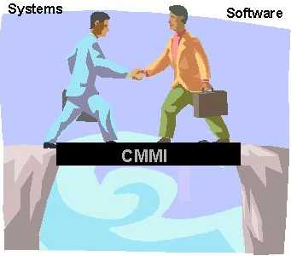
Bridging the Divide
CMMI:
Integrates systems and software disciplines into one process improvement framework.
Provides a framework for introducing new disciplines as needs arise.

Slide 8
The Next Step Is CMM Integration
The CMM Integration Project was formed to
  build an initial set of integrated models
  improve best practices from source models based on lessons learned
  establish a framework to enable integration of future models
  create an associated set of appraisal and training products
Collaborative endeavor (over 100 people involved)
  Industry
  Government
  Software Engineering Institute (SEI)

Slide 9
Enterprise-Wide Improvement
CMMI enables organizations that want to pursue process improvement in multiple functional areas to do so with less additional investment for each additional function.
  CMMI supports process integration and product improvement.
  CMMI integrates multiple disciplines into one process-improvement framework.
  CMMI provides a framework for introducing new disciplines as needs arise.

Slide 10
Bodies of Knowledge Captured in CMMI Models
An organization selects the bodies of knowledge most relevant to achieving its business objectives. Bodies of knowledge* available in CMMI models include
  software engineering(sw)
  systems engineering(se)
  integrated product and process development (IPPD)
  supplier sourcing (SS)
*Each body of knowledge related to product or process development in CMMI is considered a discipline.

Slide 11
Software Engineering (SW)
SW covers the development of software systems
SW focus on applying systematic, disciplined, and quantifiable approaches to the
  development,
  operation
  maintenance

Slide 12
System Engineering (SE)
Systems engineering covers the development of total systems, which may or may not include software
Systems engineers focus on transforming customer needs, expectations, and constraints into product solutions and supporting these product solutions throughout the life of the product

Slide 13
Integrated Product & process development (IPPD)
IPPD is a systematic approach that achieves a timely collaboration of relevant stakeholders throughout the life of the product to better satisfy customer needs, expectations, and requirements

Slide 14
Supplier sourcing (SS)
As work efforts become more complex, projects may use suppliers to perform functions or add modifications to products that are specifically needed by the project. When those activities are critical, the project benefits from enhanced source analysis and from monitoring supplier activities before product delivery

Slide 15
CMMI Models
Source Models
Capability Maturity Model for Software V2, draft C (SW-CMM V2C)
EIA Interim Standard 731, System Engineering Capability Model (SECM)
Integrated Product Development Capability Maturity Model, draft V0.98 (IPD-CMM)
CMMI-SE/SW
Staged
Representation
CMMI-SE/SW
Continuous
Representation
Combined System Engineering / Software Engineering model
Can be applied to:
  Just the software engineering projects in an organization
  Just the system engineering projects in an organization
  Both
  IPPD/SS can be used in either/both

Slide 16
Understanding CMMI Representations
There are two types of representations in the CMMI models:
  staged
  continuous
A representation allows an organization to pursue different improvement objectives
The organization and presentation of the data are different in each representation. However, the content is the same.

Slide 17
Staged Representation
Provides a proven sequence of improvements, each serving as a foundation for the next
Permits comparisons across and among organizations by the use of maturity levels
Provides an easy migration from the SW-CMM to CMMI
Provides a single rating that summarizes evaluation results and allows comparisons among organizations
Indicates maturity of an organization’s standard process -- to answer, “What is a good order for approaching improvement across the organization?”

Slide 18
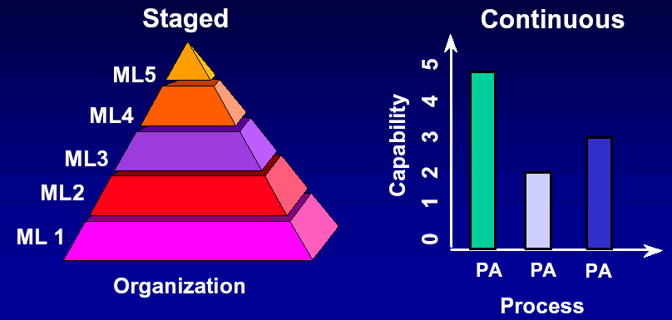
CMMI Model Representations

Slide 19
Maturity Levels
A maturity level is a well-defined evolutionary plateau of process improvement.
There are five maturity levels.
Each level is a layer in the foundation for continuous process improvement using a proven sequence of improvements, beginning with basic management practices and progressing through a predefined and proven path of successive levels.

Slide 20
The Maturity Levels
Optimizing
Optimizing
5
Focus on continuous process improvement
Quantitatively
Managed
4
Process measured
and controlled
Defined
Defined
3
Process characterized for the organization and is proactive
Managed
2
Process characterized for projects and is often reactive
Initial
1
Process unpredictable, poorly controlled, and
reactive

Slide 21
Maturity Levels Should Not
Be Skipped
Each maturity level provides a necessary foundation for effective implementation of processes at the next level.
  Higher level processes have less chance of success without the discipline provided by lower levels.
  The effect of innovation can be hidden in a
  noisy process.
Higher maturity level processes may be performed by organizations at lower maturity levels, with the risk of not being consistently applied in a crisis.

Slide 22
Maturity Level 1
Initial
Maturity Level 1 deals with performed processes.
Processes are unpredictable, poorly controlled, reactive.
The process performance may not be stable and may not meet specific objectives such as quality, cost, and schedule, but useful work can be done.

Slide 23
Maturity Level 2
Managed at the Project Level
Maturity Level 2 deals with managed processes.
A managed process is a performed process that is also:
  Planned and executed in accordance with policy
  Employs skilled people
  Adequate resources are available
  Controlled outputs are produced
  Stakeholders are involved
  The process is reviewed and evaluated for faithfulness to requirements
Processes are planned, documented, performed, monitored, and controlled at the project level. Often reactive.
The managed process comes closer to achieving the specific objectives such as quality, cost, and schedule.

Slide 24
Maturity Level 3
Defined at the Organization Level
Maturity Level 3 deals with defined processes.
A defined process is a managed process that:
  Well defined, understood, deployed and executed across the entire organization. Proactive.
  Processes, standards, procedures, tools, etc. are defined at the organizational (Organization X ) level. Project or local tailoring is allowed, however it must be based on the organization’s set of standard processes and defined per the organization’s tailoring guidelines.
Major portions of the organization cannot “opt out.”

Slide 25
Behaviors at the Five Levels
Maturity Level
Process Characteristics
Behaviors
Focus is on continuous
quantitative improvement
Focus on "fire prevention";
Optimizing
improvement anticipated and
desired, and impacts assessed.
Quantitatively
Managed
Process is measured
and controlled
Greater sense of teamwork and inter-
dependencies
Process is characterized
for the organization and
is proactive
Reliance on defined process. People understand, support and follow the process.
Defined
Process is characterized
for projects and is often
reactive
Over reliance on experience of good
Managed
people – when they go, the process
goes. “Heroics.”
Process is unpredictable,
poorly controlled, and
reactive
Focus on "fire fighting";
Initial
effectiveness low – frustration high.

Slide 26
CMMI Components
Within each of the 5 Maturity Levels, there are basic functions that need to be performed – these are called Process Areas (PAs).
For Maturity Level 2 there are 7 Process Areas that must be completely satisfied.
For Maturity Level 3 there are 11 Process Areas that must be completely satisfied.
Given the interactions and overlap, it becomes more efficient to work the Maturity Level 2 and 3 issues concurrently.
Within each PA there are Goals to be achieved and within each Goal there are Practices, work products, etc. to be followed that will support each of the Goals.

Slide 27
CMMI Process Areas

Slide 28
CMMI Terminology & Structure
Maturity Levels (1
-
5)
Process Area 1
Process Area 2
Process Area n
Required. Specific for each process area.
Specific
Generic
Required. Common across all process areas.
Goals
Goals
Common Features
Commitment
Ability
Directing
Verifying
to Perform
to Perform
Implementation
Implementation
Specific
Required
Required
Generic
Informative
Informative
Practices
Practices
Sub practices
, typical work products,
Sub practices
, typical work products,
discipline amplifications, generic
discipline amplifications, generic
practice elaborations, goal and
practice elaborations, goal and
practice titles, goal and practice notes,
practice titles, goal and practice notes,
and references
and references

Slide 29
Example
For the Requirements Management Process Area:
An example Goal (required):
“Manage Requirements”
An example Practice to support the Goal (required):
“Maintain bi-directional traceability of requirements”
Examples (suggested, but not required) of typical Work Products might be
Requirements traceability matrix or
Requirements tracking system

Slide 30
Yet another CMMI term: Institutionalization
This is the most difficult part of CMMI implementation and the portion where managers play the biggest role and have the biggest impact
Building and reinforcement of corporate culture that supports methods, practices and procedures so they are the ongoing way of business……..
  Must be able to demonstrate institutionalization of all CMMI process areas for all organizations, technologies, etc.
Required for all Process Areas

