Slide 1
Software Engineering
MCS-2
Lecture # 4

Slide 2
Prototyping Process Model
A prototype is an early sample, model or release of a product built to test a concept or process.
Prototypes are of two types.
Throwaway prototypes
  Prototypes that are eventually discarded rather than becoming a part of the finally delivered software. Examples of throwaway prototypes include screen mock-ups and story boards.
Evolutionary Prototypes
  Prototypes that evolve into the final system through iterative incorporation of user feedback.

Slide 3
Prototyping Process Model
The basic idea is that instead of freezing the requirements before a design or coding can proceed, a throwaway prototype is built to understand the requirements. This prototype is developed based on the currently known requirements.
By using this prototype, the client can get an “actual feel” of the system, since the interactions with prototype can enable the client to better understand the requirements of the desired system.
Prototyping is an attractive idea for complicated and large systems for which there is no manual process or existing system to help determining the requirements. The prototype are usually not complete systems and many of the details are not built in the prototype.
The goal is to provide a system with overall functionality.

Slide 4
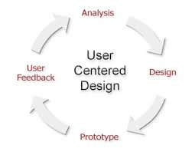
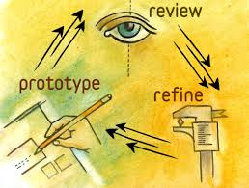
Phases
Analysis
  The user is interviewed in order to get requirements of system.
Quick Design
  It is not a detailed design but it includes important aspects of system which gives an idea to user.
Build Prototype
  It represents a “rough design” of the system.
User Evaluation
  Prototype is presented to user for evaluation.

Slide 5
Advantages
Users are actively involved in the development.
Since in this methodology a working model of the system is provided, the users get a better understanding of the system being developed.
Errors can be detected much earlier.
Quicker user feedback is available leading to better solutions.
Missing functionality can be identified easily.
Confusing or difficult functions can be identified.

Slide 6
Disadvantages
Leads to implementing and then repairing way of building systems.
Practically, this methodology may increase the complexity of the system as scope of the system may expand beyond original plans.
Incomplete application may cause application not to be used as the
full system was designed
Incomplete or inadequate problem analysis.

Slide 7
When to use Prototype model?
Prototype model should be used when the desired system needs to have a lot of interaction with the end users.
Typically, online systems, web interfaces have a very high amount of interaction with end users, are best suited for Prototype model. It might take a while for a system to be built that allows ease of use and needs minimal training for the end user.
Prototyping ensures that the end users constantly work with the system and provide a feedback which is incorporated in the prototype to result in a useable system. They are excellent for designing good human computer interface systems.

Slide 8
Good Luck ! ☻

