Slide 1
Software Engineering
MCS-2
Lecture # 5

Slide 2
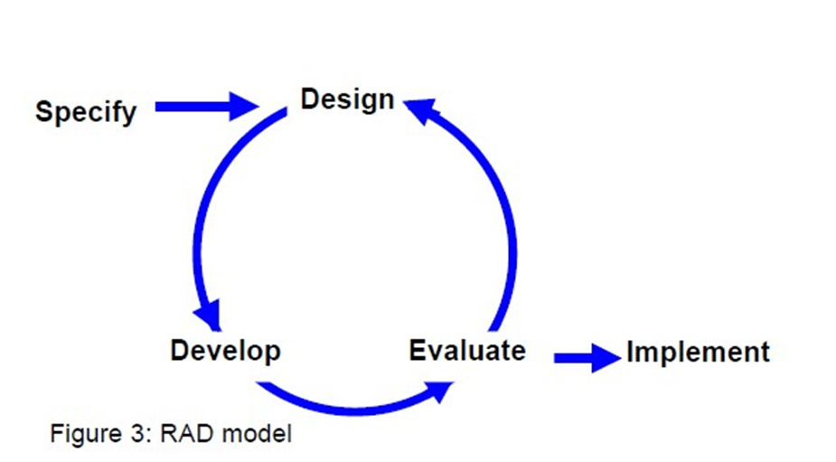
RAD (Rapid Application Development) Model
In RAD model the components or functions are developed in parallel as if they were mini projects. The developments are time boxed, delivered and then assembled into a working prototype.
This can quickly give the customer something to see and use and to provide feedback regarding the delivery and their requirements.

Slide 3
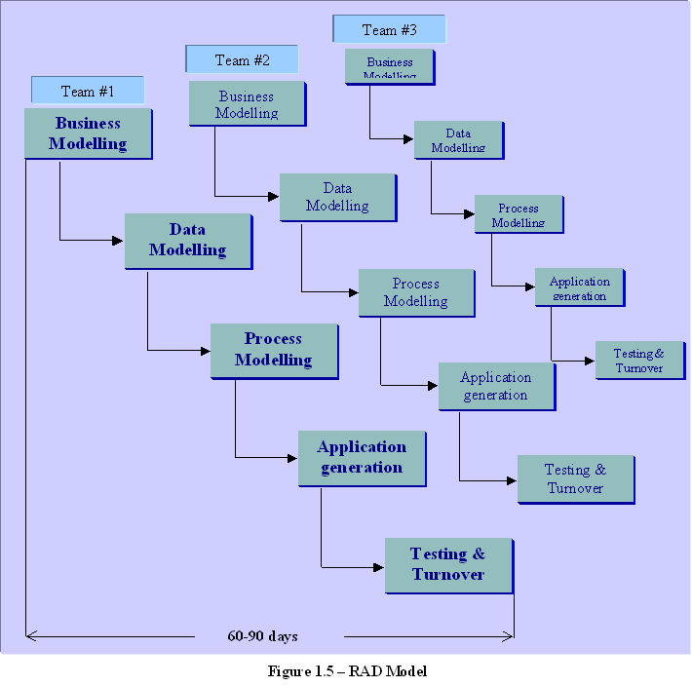
phases in the rapid application development (RAD) model
Business modeling
  The information flow is identified between various business functions.
Data modeling
  Information gathered from business modeling is used to define data objects that are needed for the business.

Slide 4
phases in the rapid application development (RAD) model
Process modeling
  Data objects defined in data modeling are converted to achieve the business information flow to achieve some specific business objective.
Application generation
  Automated tools are used to convert process models into code and the actual system.
Testing and turnover
  Test new components and all the interfaces.

Slide 5
Advantages
Reduced development time.
Increases reusability of components
Quick initial reviews occur
Encourages customer feedback
Integration from very beginning solves a lot of integration issues.

Slide 6
Disadvantages
Depends on strong team and individual performances for identifying business requirements.
Only system that can be modularized can be built using RAD.
Requires highly skilled developers / designers.
High dependency on modeling skills.
Inapplicable to cheaper projects as cost of modeling and automated code generation is very high.

Slide 7
When to use RAD model?
RAD should be used when there is a need to create a system that can be modularized in 2-3 months of time.
It should be used if there’s high availability of designers for modeling and the budget is high enough to afford their cost along with the cost of automated code generating tools.
RAD SDLC model should be chosen only if resources with high business knowledge are available and there is a need to produce the system in a short span of time (2-3 months).

Slide 8
Evolutionary Software Process Models
Evolutionary software models are iterative. They are characterized in manner that enables the software engineers to develop increasingly more complete version of a software.
This models are applied because as the requirements often change so the end product will be unrealistic, where a complete version is impossible due to tight market deadlines it is better to introduce a limited version to meet the pressure. Thus the software engineers can follow a process model that has been explicitly designed to accommodate a product that gradually complete over time.
The Evolutionary Models take the concept of “evolution” into the engineering paradigm. Therefore Evolutionary Models are iterative. They are built in a manner that enables software engineers to develop increasingly more complex versions of the software.

Slide 9
Good Luck ! ☻

