Slide 1
Software Engineering
MCS-2
Lecture # 6

Slide 2
Evolutionary Software Process Models
Evolutionary software models are iterative. They are characterized in manner that enables the software engineers to develop increasingly more complete version of a software.
This models are applied because as the requirements often change so the end product will be unrealistic, where a complete version is impossible due to tight market deadlines it is better to introduce a limited version to meet the pressure. Thus the software engineers can follow a process model that has been explicitly designed to accommodate a product that gradually complete over time.
The Evolutionary Models take the concept of “evolution” into the engineering paradigm. Therefore Evolutionary Models are iterative. They are built in a manner that enables software engineers to develop increasingly more complex versions of the software.

Slide 3
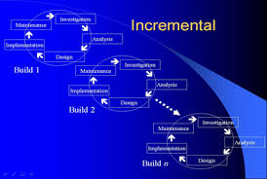

Incremental Process Model
The Incremental Model combines elements of the Linear Sequential Model (applied repetitively) with the iterative philosophy of prototyping.
In incremental model the whole requirement is divided into various builds. Multiple development cycles take place here, making the life cycle a “multi-waterfall” cycle. Cycles are divided up into smaller, more easily managed modules.
A working version of software is produced after each module.
In the diagram above when we work incrementally we are adding piece by piece but expect that each piece is fully finished.

Slide 4
Advantages
It is useful when staffing is unavailable for the complete implementation.
Can be implemented with fewer staff people.
If the core product is well received then the additional staff can be added.
Customers can be involved at an early stage.
Each iteration delivers a functionally operational product and thus customers can get to see the working version of the product at each stage.
Working software is developed at an early stage of the project.
It is easy to identify missing functions from the software at each stage.
It supports a flexible design as changes are expected with each iteration.

Slide 5
Disadvantages
Because requirements are expected to change the project may take much longer than would have been the case with other SDLC’s.

Slide 6
When to use the Incremental model?
Requirements of the complete system are clearly defined and understood.
Major requirements must be defined; however, some details can evolve with time.
There is a need to get a product to the market early.
A new technology is being used.
Resources with needed skill set are not available.
There are some high risk features and goals.

Slide 7
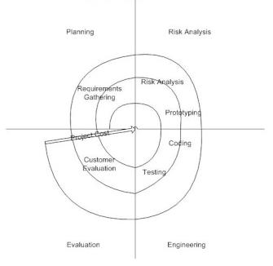
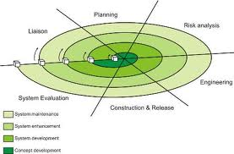
Spiral Process Model
The Spiral Model is an evolutionary software process model that couples the iterative nature of prototyping with the controlled and systematic aspects of the Linear Sequential Model.
Using the Spiral Model the software is developed in a series of incremental releases. Unlike the Iterative Model where in the first product is a core product, in the Spiral Model the early iterations could result in a paper model or a prototype.
However, during later iterations more complex functionalities could be added.

Slide 8
Task Regions of Spiral Process Model
A Spiral Model is divided into a number of framework activities, also called task regions. These task regions could vary from 3-6 in number and they are:
  Customer Communication - tasks required to establish effective communication between the developer and customer.
  Planning - tasks required to define resources, timelines and other project related information /items.
  Risk Analysis - tasks required to assess the technical and management risks.
  Engineering - tasks required to build one or more representation of the application.
  Construction & Release - tasks required to construct, test and support (eg. Documentation and training)
  Customer evaluation - tasks required to obtain periodic customer feedback so that there are no last minute surprises.

Slide 9
Advantages
Realistic approach to the development because the software evolves as the process progresses. In addition, the developer and the client better understand and react to risks at each evolutionary level.
The model uses prototyping as a risk reduction mechanism and allows for the development of prototypes at any stage of the evolutionary development.
It maintains a systematic stepwise approach, like the classic waterfall model, and also incorporates into it an iterative framework that more reflect the real world.
High amount of risk analysis hence, avoidance of Risk is enhanced.
Good for large and mission-critical projects.
Strong approval and documentation control.
Additional Functionality can be added at a later date.
Software is produced early in the software life cycle.

Slide 10
Disadvantages
One should possess considerable risk-assessment expertise.
It has not been employed as much proven models (e.g. the Waterfall Model) and hence may prove difficult to ‘sell’ to the client.
Can be a costly model to use.
Risk analysis requires highly specific expertise.
Project’s success is highly dependent on the risk analysis phase.
Doesn’t work well for smaller projects.

Slide 11
When to use Spiral model
When costs and risk evaluation is important
For medium to high-risk projects
Long-term project commitment unwise because of potential changes to economic priorities
Users are unsure of their needs
Requirements are complex
New product line
Significant changes are expected (research and exploration)

Slide 12
Good Luck ! ☻

